Slide 1
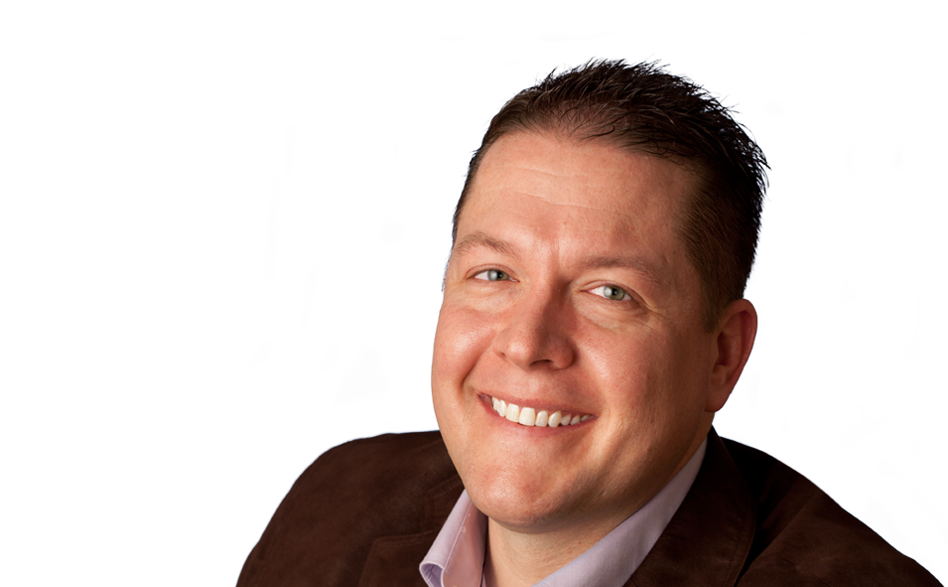
Risk Management
Program
“With AAOIC covering only orthodontists, the decision was easy. The AAO professional liability coverage is a must-have.”
Dr. Chris Edwards, Fort Worth, TX
Notes:
WELCOME TO OUR RISK MANAGEMENT PROGRAM

Slide 2
Sponsored By
the
The Orthodontists Insurance Company, a Risk Retention Group
Notes:
READ SLIDE

Slide 3
Presenters
Elizabeth Franklin
AAOIC Claims Manager
Dr. Robert Varner
AAOIC President
Chairman, AAOIC Claims Committee
Notes:
READ SLIDE

Slide 4
Today’s Program
How do I get a 10% premium discount for 2 years?
Watch the entire program
Take the test—Liz will tell you how later
If you score satisfactorily the discount will be provided
Notes:
THIS RECORDED PRESENTATION IS PROVIDED FREE OF CHARGE BY AAOIC.
IF YOU WATCH THE ENTIRE PROGRAM AND ANSWER THE QUESTIONS ASSOCIATED WITH THIS PRESENTATION, IT WILL QUALIFY YOU FOR A 10% PREMIUM REDUCTION FOR 2 YEARS.
IT WILL ALSO IN MOST CASES REDUCE YOUR CHANCES OF BEING SUED!!

Slide 5
What are we going to cover today?
Coverages and Some Legal details
Common reasons for a claim
Case examples
What can I do to decrease my risk of a lawsuit?
How can I avoid a lawsuit altogether?
Notes:
READ SLIDE.

Slide 6
DOCTOR
YOU ARE BEING SUED
Notes:
BOB
TO GET STARTED---
LET’S TAKE A TRIP—TO PERHAPS YOUR FUTURE

Slide 7
YOU GET A LETTER IN THE MAIL FROM THE COURT ANNOUNCING A PATIENT IS SUING YOU
Notes:
READ SLIDE

Slide 8
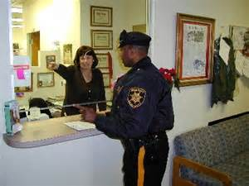

WORSE YET
A DEPUTY SHERIFF COMES TO YOUR OFFICE WHILE YOU ARE WORKING AND HANDS YOU A SUMMONS NOTIFYING YOU ARE BEING SUED
Notes:
READ SLIDE

Slide 9
AND THE WORST THING OF ALL
YOU COULD HAVE AVOIDED IT
Notes:
READ SLIDE

Slide 10
AAOIC
AAOIC IS A RISK RETENTION COMPANY—WE RETAIN UP TO $200,000 IN RISK
ANYTHING OVER $200,000 IS PAID BY RE-INSURERS WHO ARE RATED A AND A+ THEY ARE WORTH BILLIONS OF DOLLARS
THERE SHOULD NEVER BE A FEAR THAT YOUR CLAIM WILL NOT BE PAID IF A JUDGEMENT GOES AGAINST YOU
ALL WE INSURE IS ORTHODONTISTS– WE ARE “FOR ORTHODONTISTS BY ORTHODONTISTS”
THE COMPANY STARTED IN 1995 AND IS NOW 25 YEARS OLD AND WE INSURE OVER 51% OF ELIGIBLE ACTIVE AAO ORTHODONTISTS
Notes:
HOW CAN WE AVOID BEING SUED?
WE WILL ANSWER THAT QUESTION, BUT….
BEFORE WE START, LET ME TELL YOU A LITTLE BIT ABOUT YOUR COMPANY—AND
I MEAN YOUR COMPANY BECAUSE WE ARE ALL PART OF THE AAO FAMILY

Slide 11
IF YOU GET SUED
EACH CASE IS FULLY REVIEWED BY FOUR EXPERIENCED ORTHODONTISTS—NOT A CLAIMS ADJUSTER AS IN MOST INSURANCE COMPANIES
WE HAVE ATTORNEYS ALL OVER THE COUNTRY WITH EXPERIENCE IN HANDLING ORTHODONTIC MALPRACTICE CLAIMS.
WE WILL NOT SETTLE A CLAIM WITHOUT YOUR CONSENT
YOU WILL ALWAYS BE FULLY INFORMED ABOUT YOUR CASE—LIZ AND HER STAFF DO A GREAT JOB WITH THAT.
IF YOU ARE NOT INSURED WITH US, LEARN MORE ABOUT OUR COMPANY AND GET A PREMIUM QUOTE---GO TO AAOIC.COM
SIGNIFICANT DISCOUNTS TO RECENT GRADUATES AND FIRST TIME INSUREDS
Notes:
ONE BUYS INSURANCE FOR THE TIMES WHEN SOMETHING HAPPENS—
IT IS IMPORTANT TO PROTECT YOUR ASSESTS AS WELL AS YOUR PEACE OF MIND---AAOIC WILL BE THERE FOR YOU.
HERE IS WHAT HAPPENS IF YOU UNFORTUNATE TO HAVE A LAWSUIT FILED AGAINST YOU

Slide 12
Common reasons for a claim:
CLAIMS CAN COME FROM ANYWHERE AND ANY REASON AND AT ANY TIME IN YOUR PRACTICE
OUR DATA SHOWS WHERE CLAIMS ARE MOST LIKELY TO COME FROM.
MOST TIMES IT IS NOT WHAT YOU DID, IT IS WHAT YOU DIDN’T DO
Notes:
WHAT TYPES OF CASES ARE YOU MOST LIKELY TO GET SUED OVER?
WE WOULD ALL LIKE TO KNOW—WHERE IS THE RISK?
READ SLIDE

Slide 13
Common reasons for a claim:
Failure to diagnose, manage periodontal disease--21%
Root resorption-Generalized--17%
Impacted teeth—root resorption, ankylosed teeth, extended treatment times--12%
TMJ complaint (usually associated with additional complaints): 12%
Decalcifications, cavities, especially with clear aligners--7%
Other reasons: 31%
Notes:
THESE ARE THE MOST LIKELY REASONS YOU MAY BE SUED

Slide 14

Notes:
THAT OLD SAYING “WHAT YOU DON’T KNOW CAN HURT YOU” IS REALLY TRUE WHEN IT COMES TO INSURANCE
WE ARE GOING TO COVER SOME THINGS YOU REALLY NEED TO KNOW ABOUT YOUR MALPRACTICE INSURANCE.
LIZ IS GOING TO GO OVER SOME IMPORTANT POINTS YOU NEED TO BE AWARE OF
WILL NOW SHARE SOME THINGS YOU NEED TO KNOW ABOUT YOUR COVERAGE

Slide 15
Managing Your
Coverage:
Things you need to know
Notes:
Bob introduces Liz

Slide 16
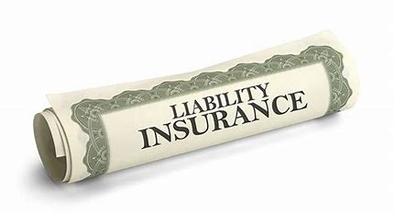
Maintain your Policy
Keep policy current and active
Know what is in the policy
Report changes to practice situation
Report claims and potential claims promptly
Notes:
LIZ
IT IS ABSOLUTELY CRITICAL FOR YOU TO KEEP YOUR POLICY CURRENT AND KNOW THE DETAILS ABOUT IT
READ SLIDE

Slide 17

Be Sure You Have the Right Coverage!
AAOIC offers limits of $1,000,000 to $6,000,000
Both Claims-Made and Occurrence Policy Forms
With both shared and separate limits for professional corporations or partnerships
Notes:
LIZ--READ THE SLIDE

Slide 18

Coverage
Who is covered: ???
Employees (other than dentists--including orthodontists) are covered, but only if practicing within the scope of their state dental practice act!
Visit AAOIC.com for more information!
Notes:
LIZ
DENTISTS AND ORTHODONTISTS ARE NOT COVERED ON YOUR POLICY—JUST YOUR OTHER EMPLOYEES
BE SURE YOU KNOW WHAT PROCEDURES ARE ALLOWED FOR YOUR ASSITANTS TO PERFORM ON PATIENTS IN YOUR STATE

Slide 19
When You Are Sued…
The main allegation will probably be that you practiced below the “standard of care”
So exactly what is the standard of care?
Notes:
LIZ--READ THE SLIDE

Slide 20
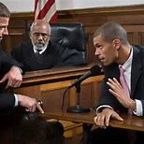
Standard of Care
It is not written anywhere
It is considered to be: “What a doctor of similar knowledge and training in your community would have done for a patient in similar circumstances”
It is based on the testimony of expert witnesses
And by decisions by judges and juries
The standard of care literally evolves over time
Notes:
LIZ--READ THE SLIDE

Slide 21
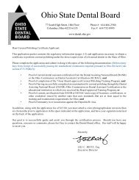
You May Also Receive A Regulatory Complaint
From your state Dental Board
You could be fined
And/or have your dental license revoked or suspended
And often times, there are findings beyond the scope of the original complaint as you are investigated!! They look at everything!!
Fortunately, AAOIC will assist you in responding to dental board complaints
Notes:
LIZ--READ THE SLIDE

Slide 22
Immediate Reporting Is Required!
“When you are first made aware of an orthodontic incident (or an alleged incident) you must immediately provide written notice of any such orthodontic incident to AAOIC”
Why?
Because the sooner we are made aware of the incident, the sooner we will be able to assist in planning the best possible strategy for you!
Notes:
READ THE SLIDE

Slide 23

What happens if I have to pay a Judgement?
ALL Carriers report all settlements/verdicts/judgements to the National Practitioners Data Bank
Information in the Data Bank is confidential
Fee refunds paid by doctors (from personal funds)—not reportable
Who can access the information in NPDB?
Regulatory agencies (State Dental Boards)
Managed Care Facilities and their legal staff
Hospitals and their legal staff
**Patients, colleagues and their legal representatives do NOT have access to info in NPDB.
Notes:
YOU MAY WORRY THAT IF A JUDGEMENT IS RULED AGAINST YOU THAT “EVERYONE” WILL KNOW.
LIZ--READ SLIDE

Slide 24
SO WHAT HAPPENS IF I GET A LAWSUIT SERVED AGAINST ME??
Report the incident immediately to AAOIC (there is a 45-day grace period)
Staff requests all patient information from insured
Staff produces a “Claim Summary Report” which includes policy number, limits of coverage, claim number/name of insured, patient/DOB, date received, attorney names (defense & plaintiff), expert witnesses, coverage, facts, informed consent, liability issues, settlement range/damages
Notes:
LIZ—READ THE SLIDE

Slide 25
SO WHAT HAPPENS IF I GET A LAWSUIT SERVED AGAINST ME??
Claims committee (4 orthodontists) reviews all records assessing standard of care and appropriateness of treatment and the level of liability for the insured (if any).
Defense Counsel is assigned, and expert witness reviews the records
Discovery: requests records from all treaters, depositions and assignment of additional experts
Attempts at settlement with consent of insured or decision to go to trial
It can take months or even years to reach a conclusion
Notes:
LIZ--READ THE SLIDE

Slide 26
HOW DO I GET OUT OF THE LAWSUIT??
There is no “easy out”--the legal process must run its course:
Trial
Fee refund
Settlement with plaintiff
Dismissal
Maybe the least intrusive method to resolve any issue is with a fee refund accompanied by a release and waiver from the patient
Refunds by insured require no reporting (personal or cashiers check – not office check)
Refunds/payments by insurance company must be reported to National Practitioner Data Bank which the state might elect to review
Notes:
THERE IS NO “GETTING OUT OF THE LAWSUIT”
READ SLIDE

Slide 27
HOW DO I GET OUT OF THE LAWSUIT??
Do not make any arrangements with a patient without consulting AAOIC—it must be done properly
Don’t assume any obligation, incur any expense or make any payment to a patient to settle a complaint without AAOIC’s prior written consent.
This requirement is to protect you, the insured and insure your legal rights
You, the insured must consent to any settlement during the process
Notes:
LIZ--READ SLIDE

Slide 28

Notes:
THANKS LIZ
NEXT SLIDE

Slide 29

RISKY LIVING:
PRACTICING WITHOUT ADEQUATE PROFESSIONAL LIABILITY INSURANCE
Notes:
BOB
CERTAINLY THERE IS SOME RISK IN LIVING IN A HOUSE THAT COULD TOPPLE OVER AT ANY MINUTE
PRACTICING WITHOUT PROPER INSURANCE IS ALSO A RISK SO MAKE SURE YOU KNOW WHAT IS IN YOUR POLICY AND ITS LIMITS
LET’S LOOK AT SOME CASES TO SEE WHERE YOUR RISK MAY COME FROM

Slide 30
Common Reasons For A Claim:
Failure to diagnose, manage periodontal disease--21%
Root resorption--17%
Impacted teeth—root resorption, ankylosed teeth, extended treatment times--12%
TMJ complaint (usually associated with additional complaints): 12%
Decalcifications, cavities, especially with clear aligners--7%
Other reasons: 31%
Notes:
LET’S GO THROUGH SOME CASES AND LEARN WHAT PROMPTED LAWSUITS
PERIODONTAL ISSUES:
THIS RISK CAN ALMOST BE COMPLETELY AVOIDED BY PROPER DIAGNOSIS AND RECORDS.
WE WILL TALK MORE ABOUT THAT LATER, RIGHT NOW LET’S LOOK AT AN EXAMPLE

Slide 31
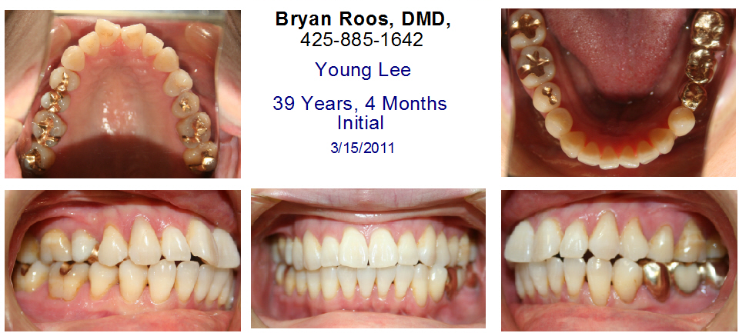
Initial Photos
Notes:
THIS ADULT PATIENT WANTED TO HAVE HER TEETH STRAIGHTENED

Slide 32
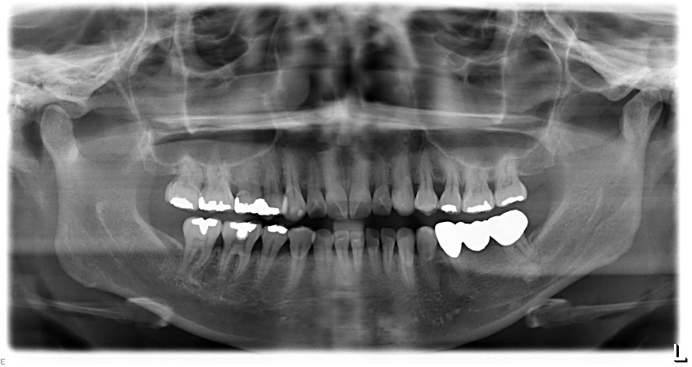
Initial Panoramic X-Ray
Notes:
THE INITIAL XRAY SHOWED GENERALIZED BONE LOSS—
EVEN THOUGH THERE WAS A HISTORY OF PERIODONTAL DISEASE, THERE IS NO NOTE IN THE CHART MENTIONING IT

Slide 33
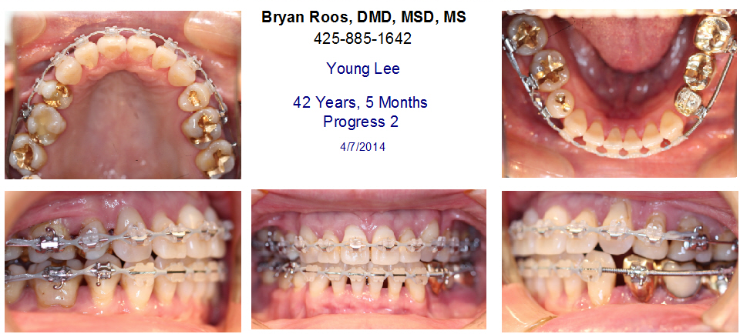
Progress (36 months)
Notes:
TREATMENT SEEMED TO PROCEED WNL THE PATIENT MISSED SOME APPOINTMENTS SLOWING PROGRESS

Slide 34
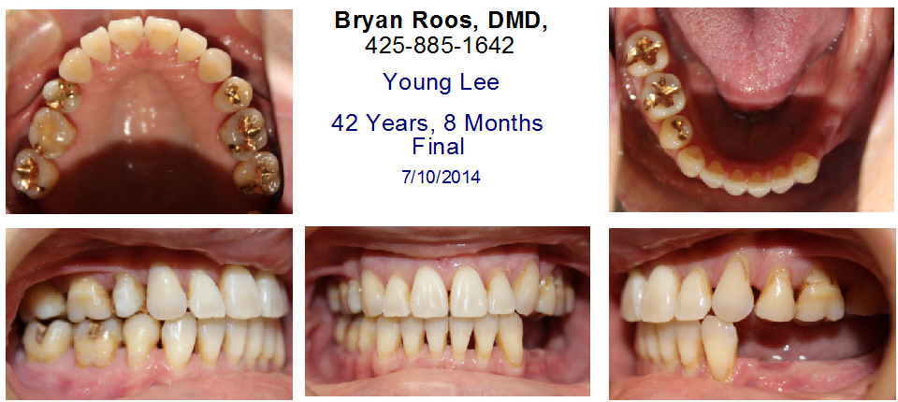
Final Photos
Notes:
FINAL PHOTOS SHOW A PRETTY NICE CASE—BUT NOTE THE LOWER LEFT BRIDGE IS MISSING

Slide 35
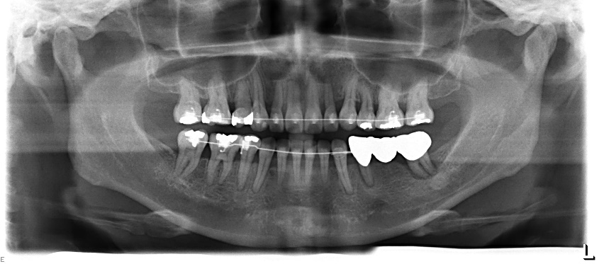
Notes:
HERE WAS A PROGRESS PANOREX THAT WASN’T READ BY THE INSURED—
NOTE THE RADIOLUCENCIES ON THE ABUTMENTS AND MORE BONE LOSS AROUND THE TEETH

Slide 36
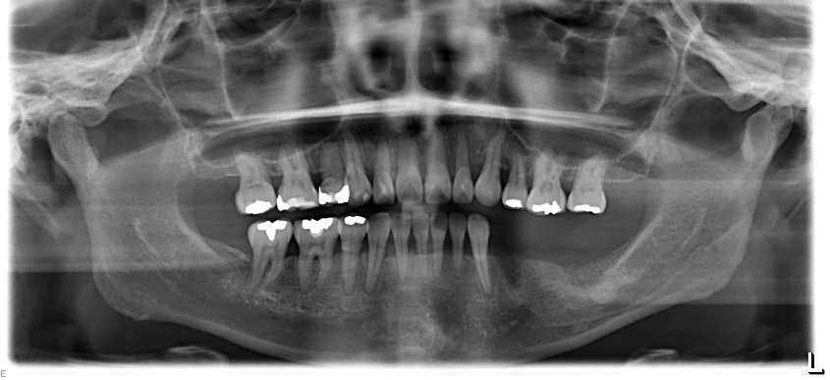
3-15-2011
Initial
7-10-2014
Final
Notes:
THE FINAL XRAY SHOWED SIGNIFICANT BONE LOSS IN ADDITION TO THE BONE LOSS PRIOR TO TREATMENT AND THE LOWER LEFT BRIDGE WAS LOST.
THE PATIENT COMPLAINED ABOUT LOOSE TEETH AND NUMBNESS ON THE LOWER LEFT SIDE TO HER DENTIST
WHAT HAPPENED???

Slide 37
Failure To Diagnose And Manage Periodontal Problems
What did our insured fail to do?
Did not obtain periodontal clearance before starting treatment. The patient had a history of perio
Bone loss is not recognized or ignored! Obvious generalized bone loss on initial film but no notation in the chart
Did NOT READ progress xrays—did not see abscess development or continuing bone loss
Did not refer for perio maintenance during treatment
Bone loss progressed during treatment
Lower left bridge lost!
Notes:
PATIENT SUED AND THE CASE WAS SETTLED FOR WELL OVER $300,000.

Slide 38
WHAT CAN YOU DO?
Evaluate the patient’s periodontal condition
Notes:
SO WHAT CAN YOU DO TO AVOID A PERIODONTAL TYPE LAWSUIT?

Slide 39
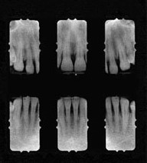
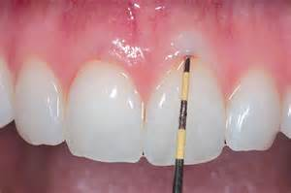
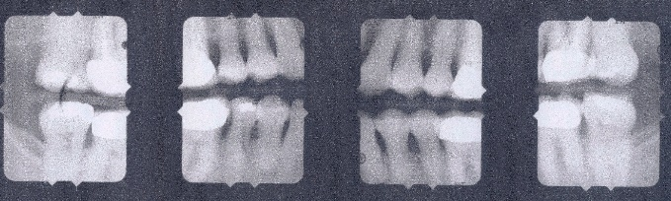
Failure To Diagnose And Manage Periodontal Problems
Do it yourself with a perio probe, bitewings and anterior Periapicals
Document the clearance in the patient’s chart!!
Notes:
YOU CAN EVALUATE THE PERIODONTAL CONDITION YOURSELF WITH THE APPROPRIATE XRAYS AND A PERIODONTAL PROBE OR

Slide 40
Failure to Diagnose, Manage Periodontal Issues
Clear your patient for orthodontic treatment
If you don’t do it yourself, refer to their dentist for clearance—view the probing chart or,
Refer your patient to a Periodontist for evaluation
DOCUMENT THE CLEARANCE IN THE CHART!!!
Clearly inform your patient of the risks
We recommend using the supplemental Informed Consent for patients with periodontal issues
Notes:
YOU CAN REFER TO THEIR DENTIST OR A PERIODONTIST—LET THEM KNOW WHAT YOU ARE PLANNING FOR TREATMENT AND ASK IF THE PERIODONTAL CONDITION WILL SUPPORT WHAT YOU PLAN TO DO. GET A RESPONSE IN WRITING!! I THINK THIS IS A MUST IF THE PATIENT HAS A HISTORY OF PERIODONTAL DISEASE.
WHAT EVER METHOD YOU USE TO EVALUATE THE PATIENT’S PERIODONTAL CONDITION
IT MUST BE DONE AND ACCOUNTED FOR IN THE RECORDS.
REMEMBER IF YOU DO IT AND DON’T WRITE INTO THE PATIENT’S RECORD IT IS THE SAME AS NOT DOING IT AT ALL.
I KNOW YOU ALL KNOW THIS—BUT WRITE EVERYTHING DOWN IN THE CHART!!

Slide 41
Common Reasons For A Claim:
Failure to diagnose, manage periodontal disease--21%
Root resorption--17%
Impacted teeth—root resorption, ankylosed teeth-extended treatment times--12%
TMJ complaint (usually associated with additional complaints)-- 12%
Decalcifications, cavities, especially with clear aligners--7%
Other reasons--31%
Notes:
AS WE ALL KNOW, THE RISK OF ROOT RESORPTION DURING TREATMENT IS A REALITY.
IT IS A QUESTION OF: HOW MUCH AND WAS IT MONITORED AND DID YOU INFORM THE PATIENT/PARENT?
THE HARDEST TO DEFEND CASES WE SEE IS ONES WHERE THE ROOT RESORPTION IS DISCOVERED BY THE GENERAL DENTIST AND THE ORTHODONTIST HAD NO PROGRESS XRAYS OR SOMETIMES NO POST TREATMENT XRAYS TO DEFEND THE INSURED WITH.

Slide 42
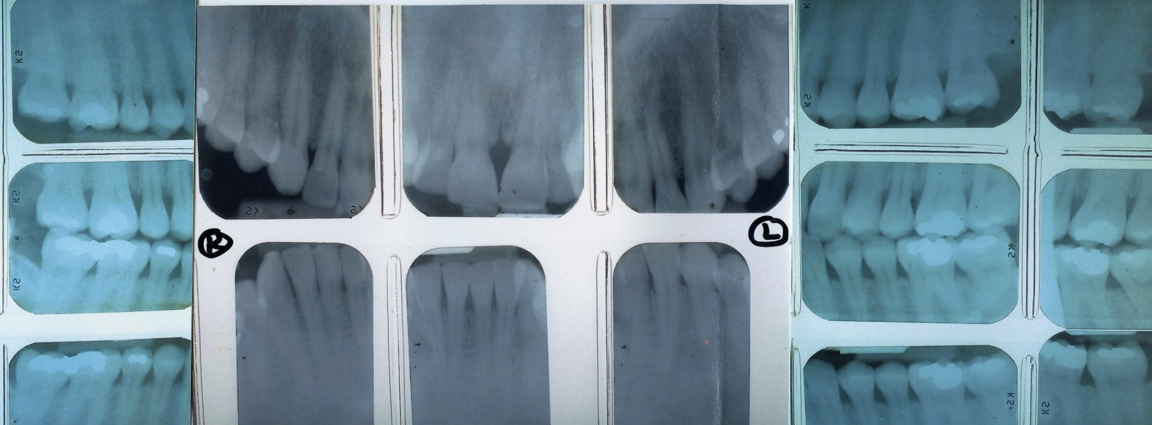
FAILURE to NOTICE ROOT RESORPTION
Pre-Treatment
Notes:
HERE IS A CASE—AN ADULT WITH GOOD LONG ROOTS---PRE-TREATMENT

Slide 43
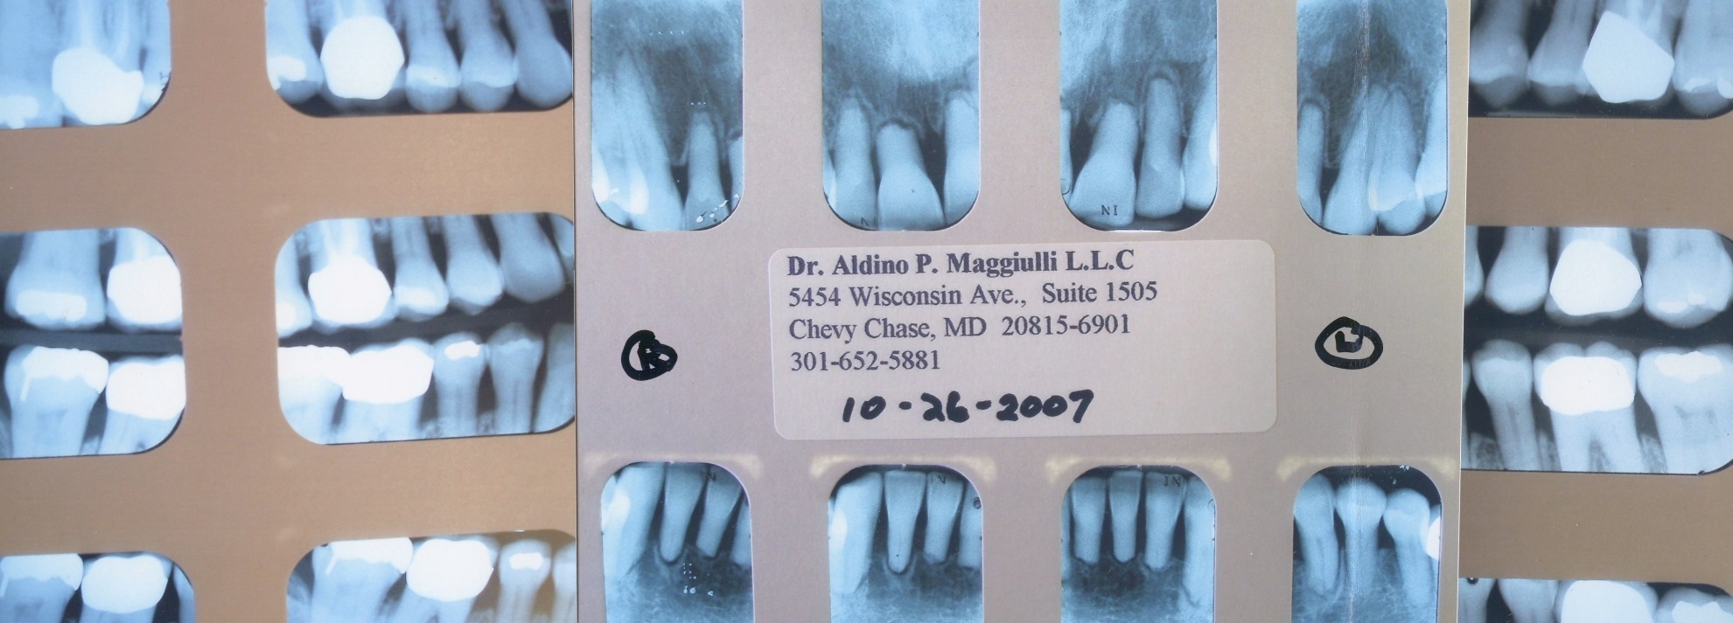
FAILURE to NOTICE ROOT RESORPTION
Post Treatment
Notes:
HERE IS THE SAME CASE POST TREATMENT.
THERE WERE NO PROGRESS RECORDS AND THE ROOT RESORPTION WAS NOT MENTIONED BY THE INSURED.
THIS IS A POST TREATMENT XRAY TAKEN BY THE PATIENT’S GENERAL DENTIST
PROGRESS XRAYS WOULD HAVE REVEALED THE RESORPTION AND A COURSE OF ACTION DISCUSSED WITH THE PATIENT.

Slide 44
WHAT DID OUR INSURED FAIL TO DO?
Did not take any progress xrays which would have revealed the resorption
Did not take any final xrays where he could have discovered the resorption
Did not inform the patient that resorption occurred during treatment
Notes:
READ SLIDE:
AGAIN, FAILURE TO DO WHAT SHOULD HAVE BEEN DONE LEAD TO THIS LAWSUIT

Slide 45
Common reasons for a claim:
Failure to diagnose, manage periodontal disease--21%
Root resorption--17%
Impacted teeth—root resorption, ankylosed teeth, extended treatment time--12%
TMJ complaint (usually associated with additional complaints): 12%
Decalcifications, cavities, especially with clear aligners--7%
Other reasons: 31%
Notes:
SOME OF THE LONGEST TREATMENT TIMES WE HAVE AS ORTHODONTIST IS WHEN WE HAVE TO RECOVER IMPACTED TEETH.
THERE IS SIGNIFICANT LITERATURE THAT SUGGESTS THE POSITION OF IMPACTED CANINES PRIOR TO TREATMENT PREDISPOSES THE PATIENT FOR ROOT RESORPTION—PARTICULARLY ON THE LATERAL INCISORS.
GOOD XRAY EVIDENCE HELPS US TO DETERMINE WHEHTER THERE IS PRE-EXISTING ROOT RESORPTION AND THE POSTION OF THE CANINES SO WE KNOW WHICH WAY TO MOVE THEM.
IN MY PRACTICE, I ALWAYS HAD A CBCT IMAGE PRODUCED FOR ALL IMPACTED TEETH.
THE INFORMATION YOU PROVIDE TO YOUR PATIENTS BEFORE TREATMENT IS CRITICAL—THEY NEED TO KNOW THE POSSIBLE RISKS. THAT OLD SAYING IS TRUE: “WHAT YOU TELL YOUR PATIENTS BEFORE TREATMENT IS WISDOM, WHAT YOU TELL THEM AFTER SOMETHING HAPPENS IS AN EXCUSE”!!

Slide 46
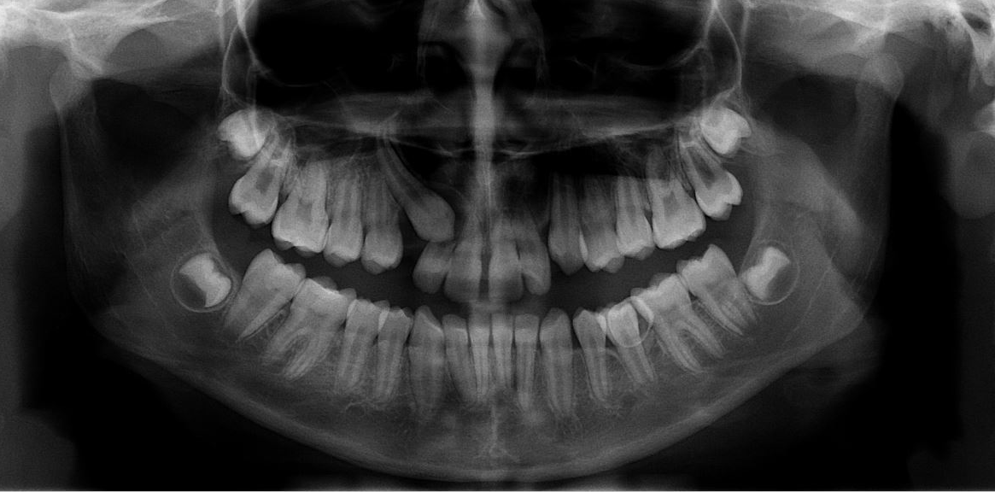
EXAMPLES OF ROOT RESORPTION WITH IMPACTIONS
Notes:
HERE IS THE INTIAL XRAY WITH A MESIALLY INCLINED CANINE

Slide 47
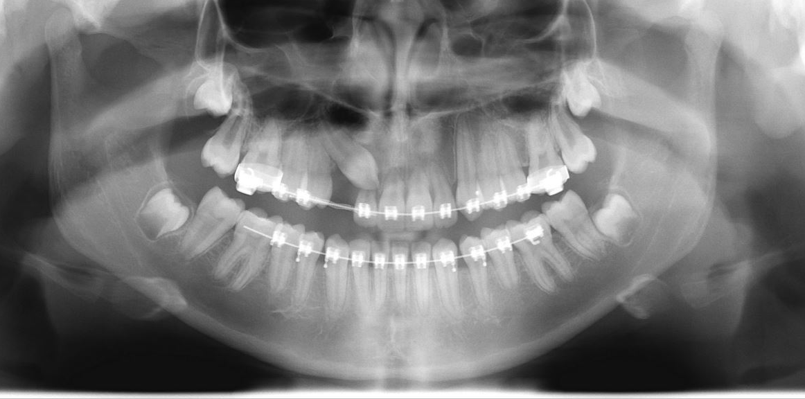
EXAMPLES OF ROOT RESORPTION WITH IMPACTIONS
Notes:
SPACE MADE FOR THE CANINE NOTICE THE LATERAL INCISOR

Slide 48
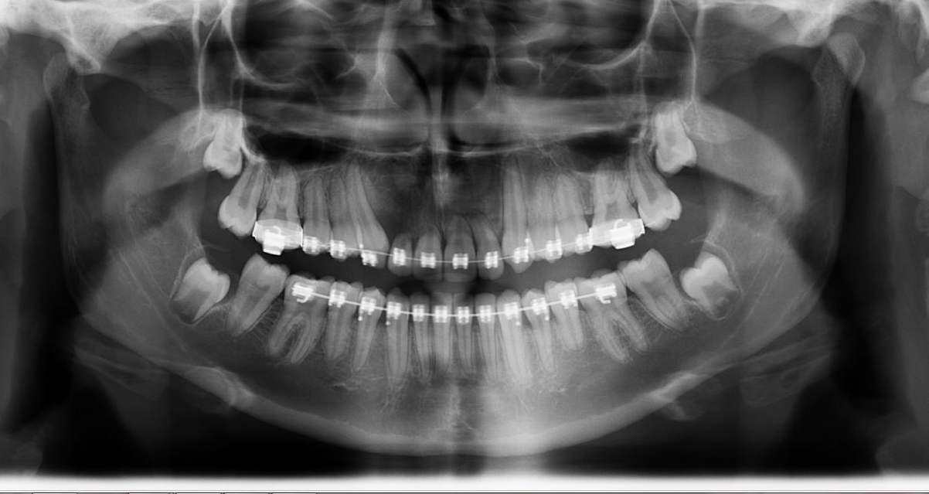
EXAMPLES OF ROOT RESORPTION WITH IMPACTIONS
Notes:
39 MONTHS INTO TREATMENT , CANINE IS RECOVERED BUT LOOK AT THE UPPER ANTERIOR TEETH

Slide 49
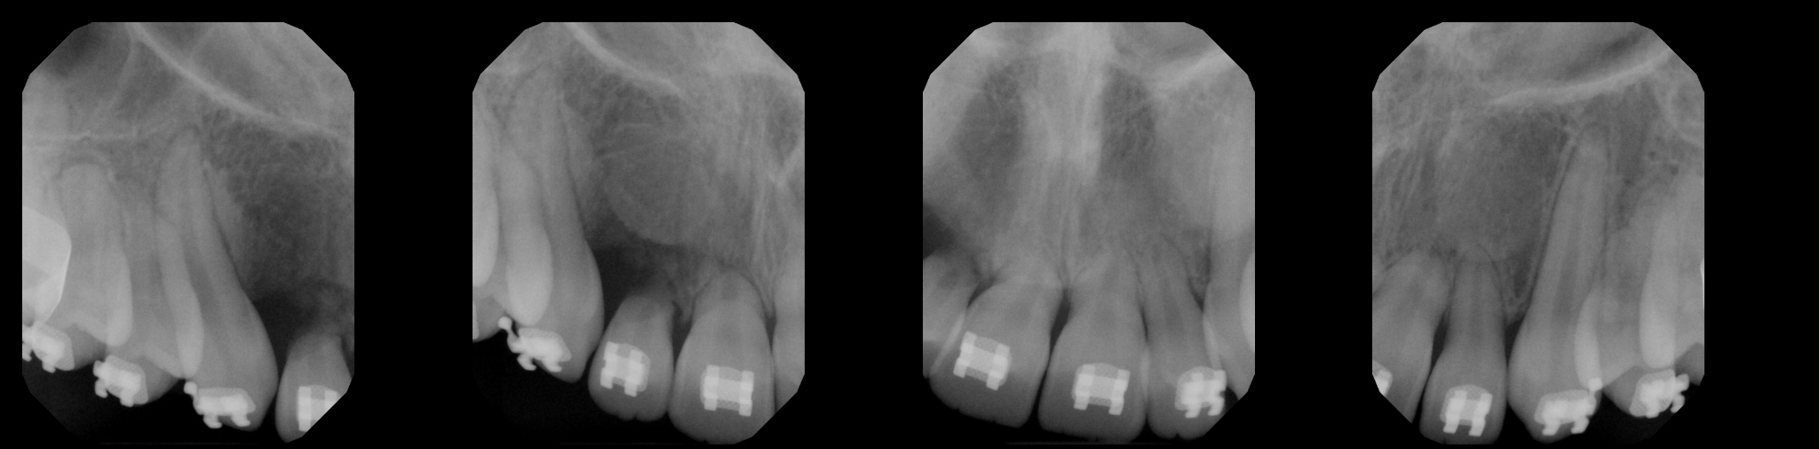
EXAMPLES OF ROOT RESORPTION WITH IMPACTIONS
Notes:
ABNORMAL AND SIGNIFICANT ROOT RESORPTION OF NOT ONLY THE UPPER RIGHT LATERAL BUT THE RIGHT AND LEFT CENTRAL INCISORS

Slide 50
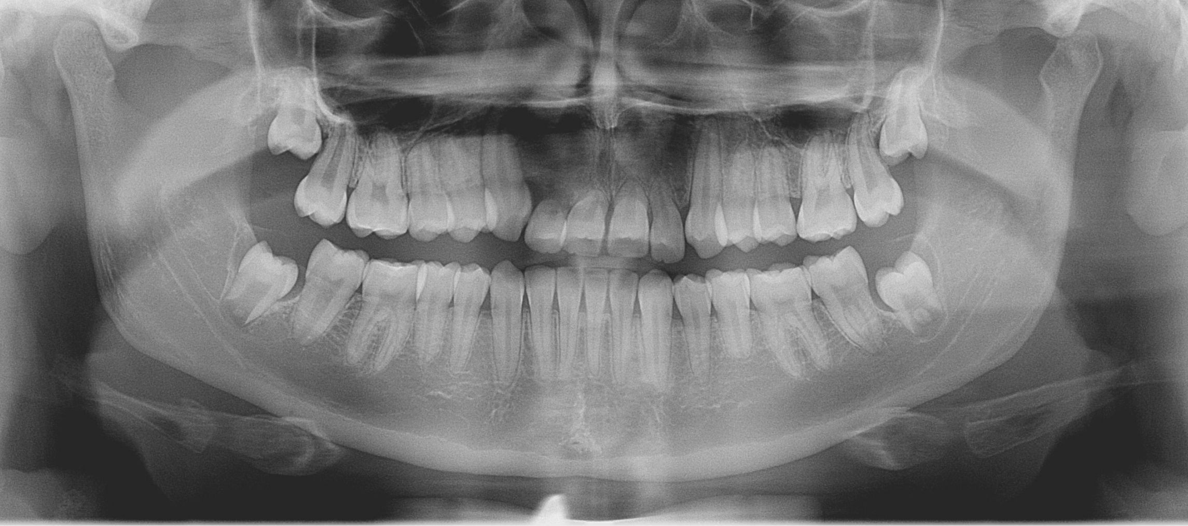
EXAMPLES OF ROOT RESORPTION WITH IMPACTIONS
Notes:
THE FINAL PANOREX AFTER 40 MONTHS OF TREATMENT

Slide 51
EXAMPLES OF ROOT RESORPTION WITH IMPACTIONS
So what did our insured fail to do?
There was no informed consent, which hinders any defense
While the insured did mention possible root resorption of the right lateral incisor, he did not mention the possibility of other teeth resorbing and it was not documented in the chart.
The demand was initially $95,000
The plaintiff is a teenage girl that will make a sympathetic witness especially if any anterior teeth are lost
Settled at mediation for $30,000
Notes:
READ SLIDE

Slide 52
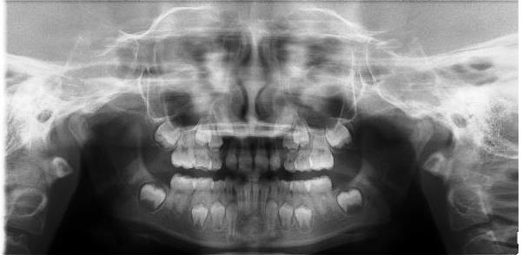
EXAMPLES OF ROOT RESORPTION WITH IMPACTIONS
8/16/11
Notes:
HERE IS AN EXAMPLE OF MONITORING A PATIENT. THIS PATIENT DID NOT HAVE BRACES, JUST A LOWER LINGUAL ARCH.
THE AUGUST 2011 PANOREX SHOWS NO APPARENT ROOT RESORPTION BUT POOR POSITIONS OF THE DEVELOPING CANINES

Slide 53
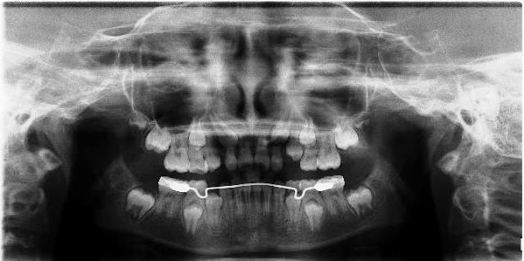
EXAMPLES OF ROOT RESORPTION WITH IMPACTIONS
4/4/13
Notes:
THE APRIL 2013 SHOWS SIGNIFICANT RESORPTION OF THE LATERAL INCISORS.
THE PARENTS WERE UNHAPPY THAT THIS WAS NOT CAUGHT SOONER—AND A LAWSUIT WAS FILED--SHOULD AN XRAY HAVE BEEN TAKEN IN 2012??
GIVEN THE POSITION OF THE DEVELOPING CANINES PROBABLY YES!

Slide 54
WHAT DID OUR INSURED FAIL TO DO?
Did not take adequate progress xrays which would have revealed the resorption
Did not warn the parents of potential root resorption based on the original position of the erupting canines
Notes:
THE LACK OF PROGRESS XRAYS WHICH WOULD HAVE DISCOVERED THE ROOT RESORPTION
SO THE PATIENT COULD HAVE BEEN INFORMED AND ALTERNATIVES DISCUSSED

Slide 55
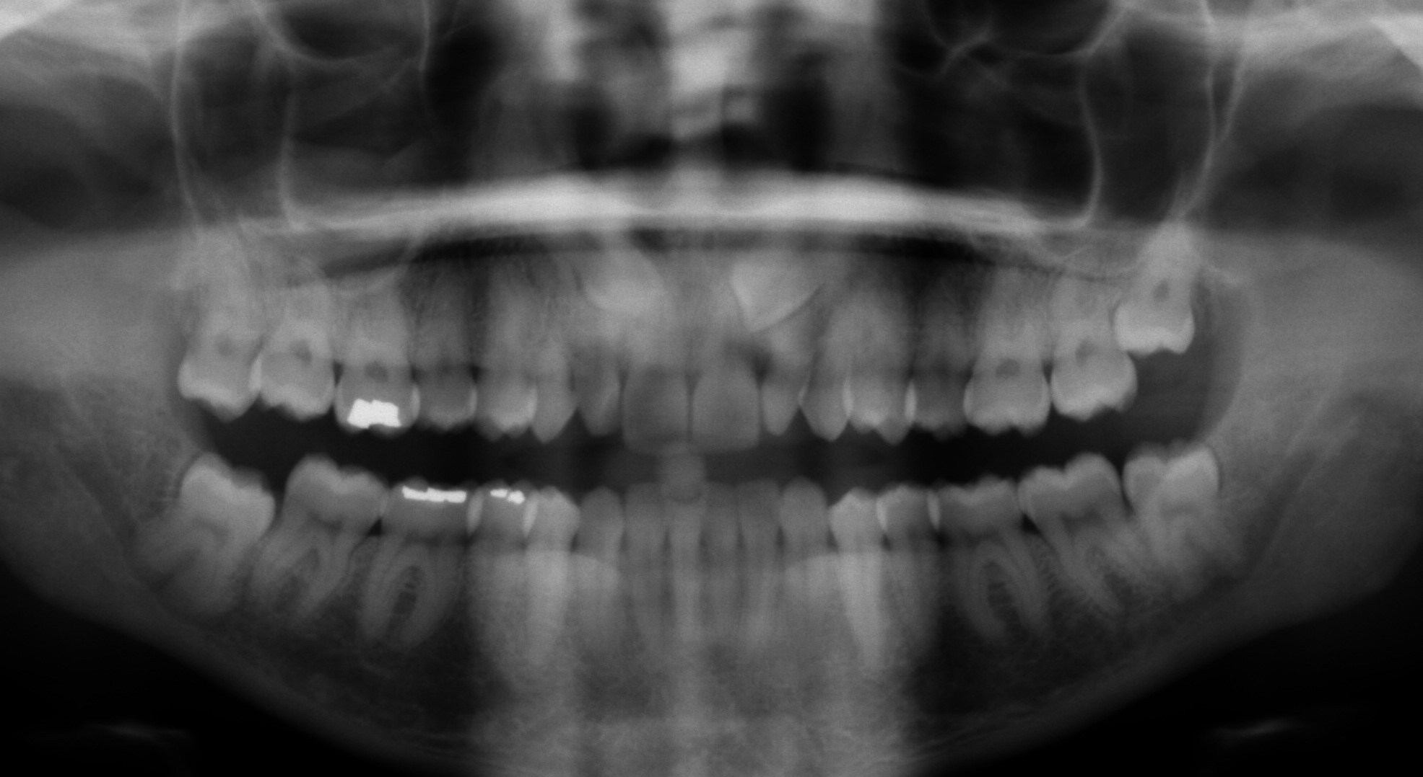
EXAMPLES OF ROOT RESORPTION WITH IMPACTIONS
Notes:
BUT WHAT IF YOU DOCUMENT THE RECOVERY OF AN IMPACTION LIKE THIS CASE?

Slide 56
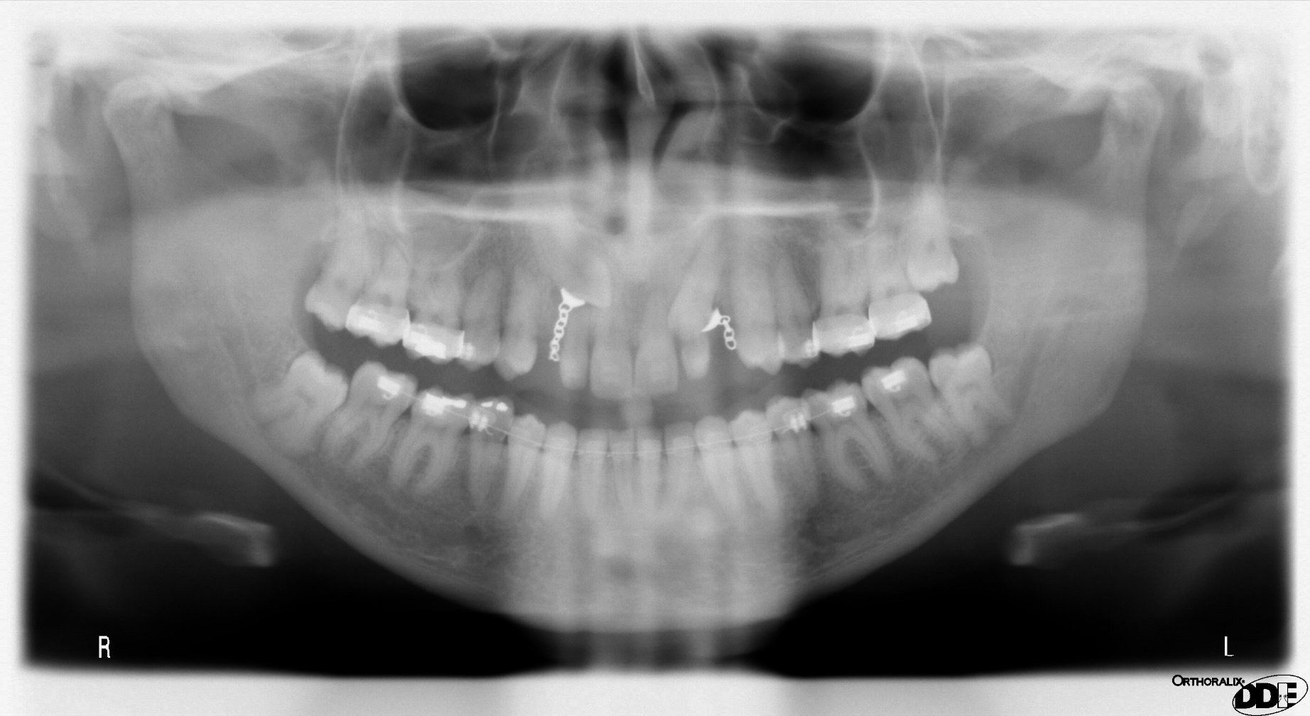
EXAMPLES OF ROOT RESORPTION WITH IMPACTIONS
Notes:
RECOVERY HAS BEGUN

Slide 57
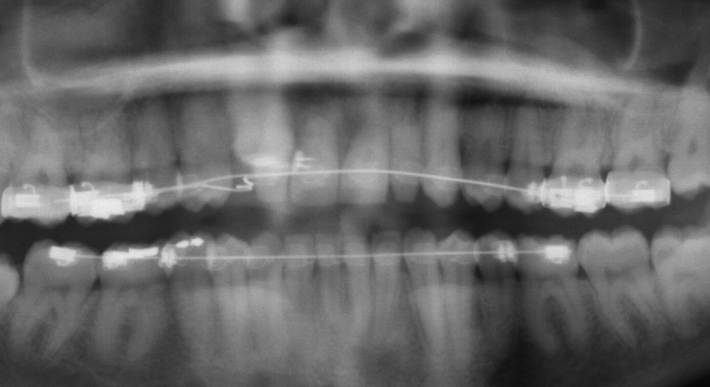
EXAMPLES OF ROOT RESORPTION WITH IMPACTIONS
Notes:
LEFT CANINE IS IN AND THE RIGHT-- ALMOST—NOTE A LITTLE ROOT RESORPTION ON THE CENTRAL AND LATERALS

Slide 58
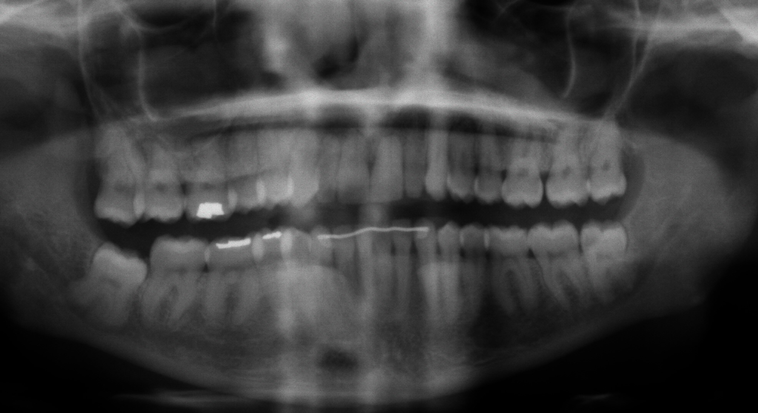
EXAMPLES OF ROOT RESORPTION WITH IMPACTIONS
Notes:
THE FINAL PANOREX---NOT MUCH ROOT RESORPTION---SHOULDN’T BE A PROBLEM RIGHT?
THE PATIENT’S PARENTS FILED A LAWSUIT ALEDGING THEY NEVER WERE TOLD ABOUT THE POSSIBILITY OF ROOT RESORPTION-EVEN THOUGH SHE WAS AT RISK FROM THE VERY BEGINNING AND IT COULD BE SEEN HAPPENING DURING THE RECOVERY
THE INSURED DID NOT MENTION THE RISK IN HIS CHART BEFORE TREATMENT,
HE DID NOT MENTION IT DURING TREATMENT EVEN THOUGH IT WAS EVIDENT ON THE PROGRESS XRAY AND
HE DID NOT MENTION IT AFTER TREATMENT WAS COMPLETED. IT WAS THE GENERAL DENTIST THAT BROUGHT IT UP.
SO EVEN THOUGH YOU HAVE PROGRESS RECORDS—IF YOU DON’T READ YOUR FILMS, IF YOU DO NOT DOCUMENT THE XRAY EVIDENCE IN YOUR CHART AND TALK TO YOUR PATIENTS/PARENTS--- YOU HAVE CREATED AN ENVIRONMENT WHERE YOU CAN BE HELD LIABLE.

Slide 59
WHAT DID OUR INSURED FAIL TO DO?
THE INSURED DID NOT MENTION THE RISK TO THE PARENTS AND DOCUMENT IN HIS CHART BEFORE TREATMENT,
HE DID NOT MENTION IT DURING TREATMENT EVEN THOUGH IT WAS EVIDENT ON THE PROGRESS XRAY AND
HE DID NOT MENTION IT AFTER TREATMENT WAS COMPLETED. IT WAS THE GENERAL DENTIST THAT BROUGHT IT UP.
Notes:
THE LACK OF PROGRESS XRAYS WHICH WOULD HAVE DISCOVERED THE ROOT RESORPTION SO THE PATIENT COULD HAVE BEEN INFORMED AND ALTERNATIVES DISCUSSED
THERE WAS NO FINAL XRAYS TAKEN SO THE INSURED DID NOT INFORM THE PATIENT—IT WAS THE GENERAL DENTIST THAT DISCOVERED THE RESORPTION

Slide 60
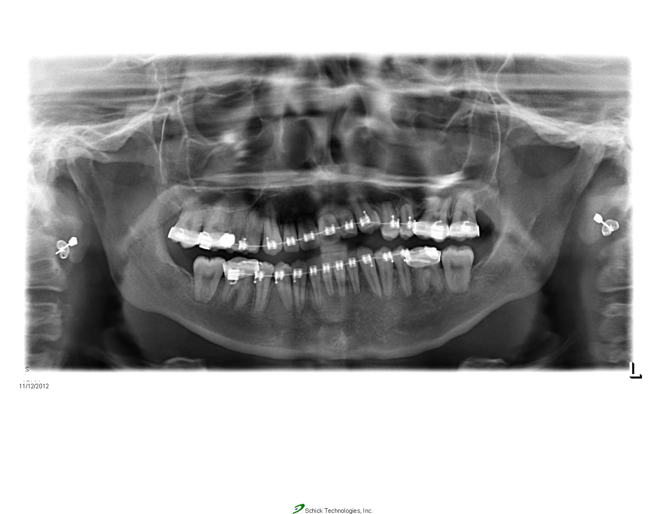
EXAMPLES OF ROOT RESORPTION WITH IMPACTIONS
ANKYLOSED LEFT CANINE
Notes:
HERE IS AN IMPACTED LEFT CANINE THE ORTHODONTIST KEPT PULLING ON—IT WOULD NOT MOVE DOWN, BUT ALL THE REST OF THE FRONT TEETH MOVED UP!!

Slide 61
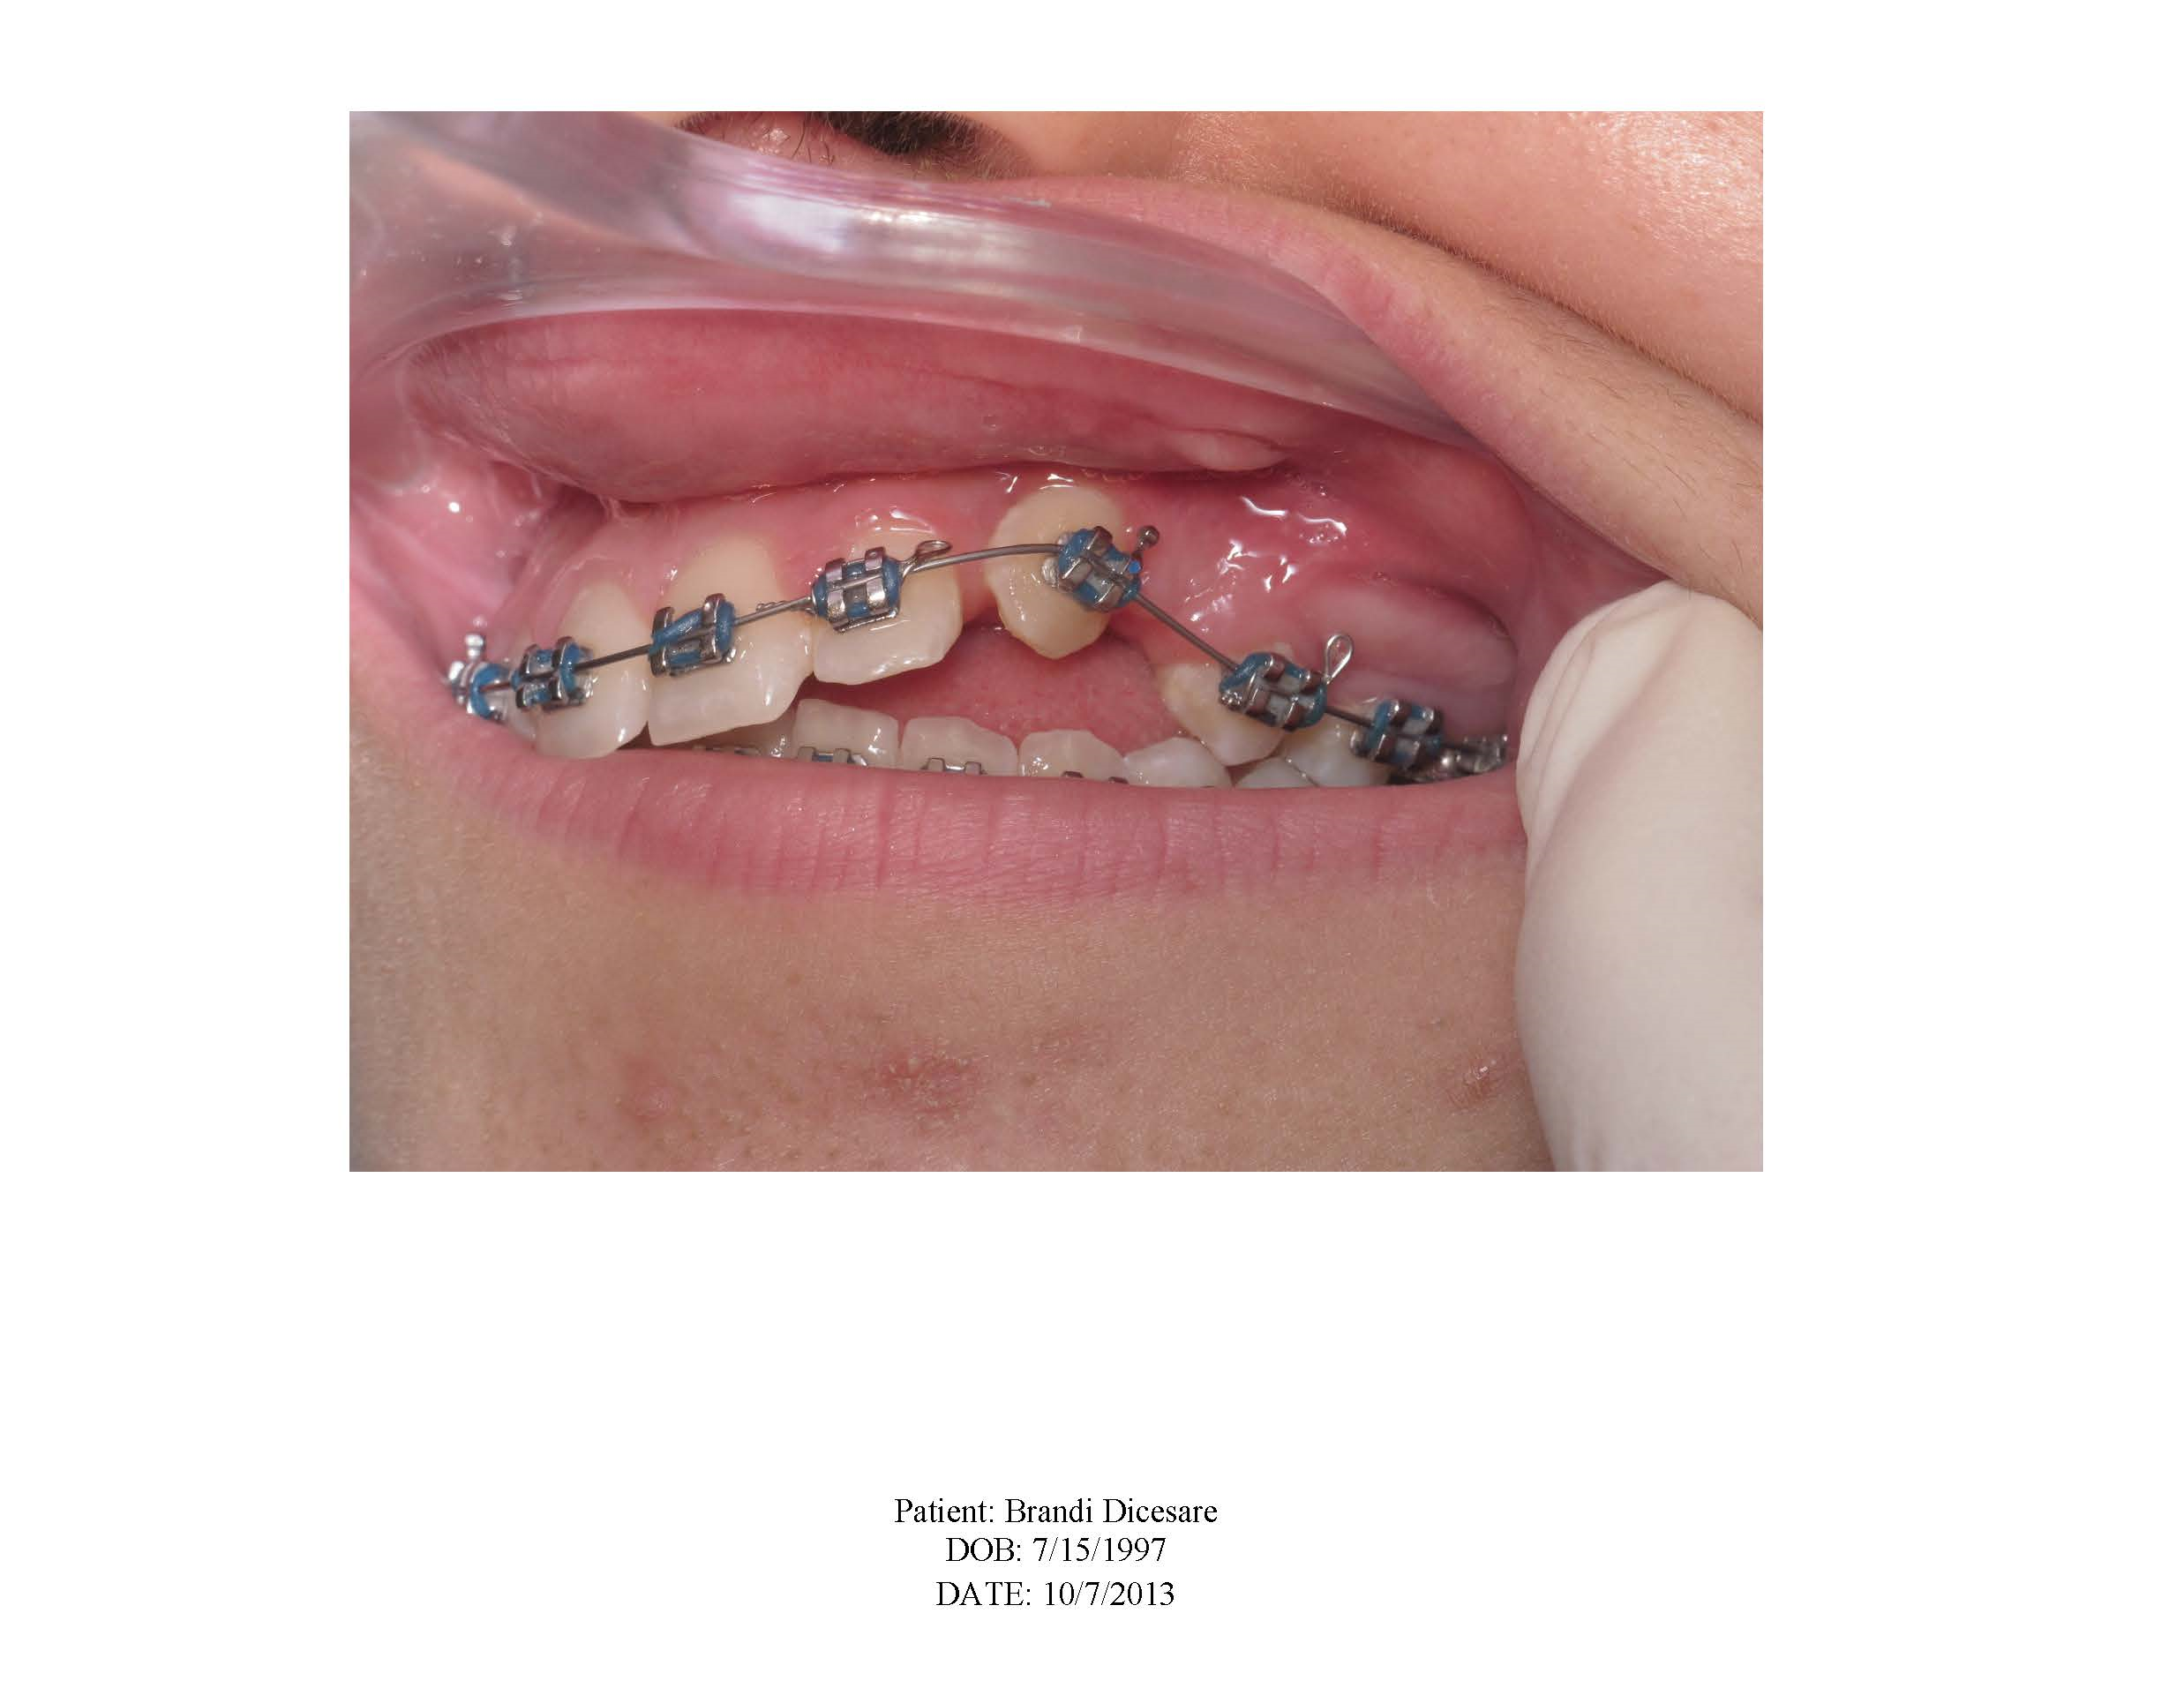
EXAMPLES OF ROOT RESORPTION WITH IMPACTIONS
Notes:
OCCASIONALLY AN IMPACTED TOOTH WILL NOT MOVE. BE VIGILANT AND TAKE PROGRESS IMAGES.
AND BE PROACTIVE— DON’T JUST KEEP PULLING ON IT IF IT IS NOT MOVING—IDENTIFY WHAT IS PREVENTING IT FROM MOVING.
IF AFFECTING ADJACENT TEETH AS IN THIS CASE, CONSIDER THE USE OF TADS FOR ALTERNATE ACHORAGE.

Slide 62
ROOT RESORPTION WITH IMPACTIONS SUMMARY
THE MORAL OF THIS STORY IS THAT RESORPTION WILL OCCUR AND OCCASIONALLY AN IMPACTED TOOTH WILL NOT MOVE.
BE VIGILANT AND TAKE PROGRESS IMAGES.
MAKE SURE YOU HAVE EXPLAINED THE RISKS OF ROOT RESORPTION OR THE POSSIBILITY OF ANKYLOSIS—BEFORE STARTING TREATMENT
IF YOU SEE ROOT RESORPTION OCCURING OR AN IMPACTED TOOTH NOT MOVING---BE PROACTIVE
Notes:
READ THE SLIDE

Slide 63
ROOT RESORPTION WITH IMPACTIONS SUMMARY
INFORM THE PATIENT AND PARENTS. SOME LITERATURE SUGGESTS STOPPING ALL TOOTH MOVEMENT FOR A TIME WILL SLOW DOWN OR STOP ROOT RESORPTION.
FOR AN IMPACTED TOOTH THAT HAS STOPPED MOVING, SOME SUGGEST LUXATING THE TOOTH MAY ALLOW IT TO MOVE—OR MAYBE THERE IS BONE IN THE WAY, DON’T JUST KEEP PULLING ON IT IF IT IS NOT MOVING—IDENTIFY WHAT IS PREVENTING IT FROM MOVING. ALSO, CONSIDER THE USE OF TADS AS ALTERNATE ANCHORAGE
IF A TOOTH WON’T MOVE OR IF THE ROOT RESORPTION IS SIGNIFICANT, YOU AND THE PATIENT/PARENTS WILL HAVE TO WEIGH THE BENEFITS OF CONTINUING TREATMENT VERSUS DISCONTINUING TREATMENT—AND DOCUMENT IT ALL IN THE CHART!!
Notes:
READ THE SLIDE

Slide 64
Common reasons for a claim: What is the incidence?
Failure to diagnose, manage periodontal disease--21%
Root resorption--17%
Impacted teeth—time plus root resorption, ankylosed teeth--12%
TMJ complaint (usually associated with additional complaints): 12%
Decalcifications, cavities, especially with clear aligners--7%
Other reasons: 31%
Notes:
WE DON’T SEE MANY TMJ COMPLAINTS AS THE MAIN ISSUE.
TMD SYMPTOMS ARE USUALLY “THROWN IN” TO AUGMENT OTHER ISSUES.
THERE IS A GREAT DEAL OF EVIDENCE IN THE LITERATURE THAT SUGGESTS THAT ORTHODONTIC TREATMENT DOES NOT CAUSE NOR PREVENT TMD/TMJ SYMPOMS.
HOWEVER, TO PROTECT YOURSELF, DOCUMENT THE CONDITION OF THE TMJ DURING YOUR EXAMINATION: RANGE OF MOTION, JOINT NOISES, HISTORY—JUST MAKE SURE YOU KNOW THE CONDITION OF THE JOINTS AND MONITOR THEM DURING TREATMENT

Slide 65
Common reasons for a claim: What is the incidence?
Failure to diagnose, manage periodontal disease--21%
Root resorption--17%
Impacted teeth—time plus root resorption, ankylosed teeth--12%
TMJ complaint (usually associated with additional complaints): 12%
Decalcifications, cavities, especially with clear aligners--7%
Other reasons: 31%
Notes:
ALTHOUGH DECALCIFICATIONS IS ONLY 7% OF THE COMPLAINTS—AND AGAIN,
THESE ARE USUALLY ASSOCIATED WITH OTHER COMPLAINTS—AND ARE
MOST OFTEN ASSOCIATED WITH A NON-COMPLIANT PATIENT—
THESE CAN RESULT IN SIGNIFICANT SETTELEMENT AMOUNTS.
LATELY WE HAVE BEEN SEEING PATIENTS THAT HAVE DECALCIFICATIONS ON EVERY TOOTH IN THE MOUTH—FROM EATING AND DRINKING WITH CLEAR ALIGNERS IN THE MOUTH

Slide 66
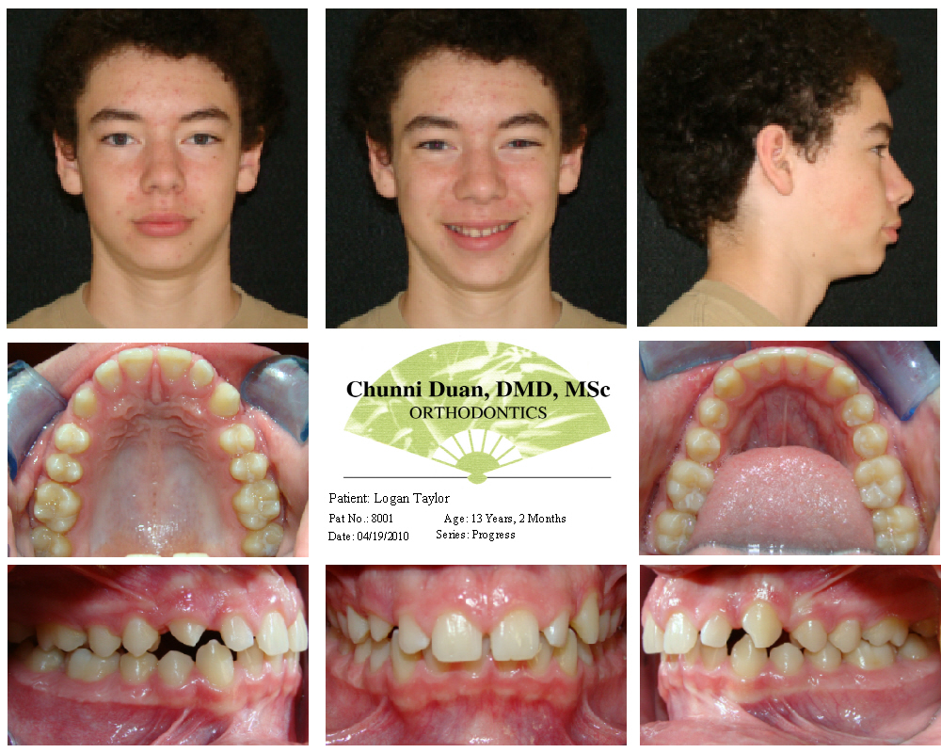
DECALCIFICATION FROM ALIGNERS
APRIL 2010
Notes:
HERE IS AN ALIGNER CASE AS AN EXAMPLE OF WHAT CAN HAPPEN—THIS IS THE APRIL 2010 PRE TREATMENT PHOTOS
DECALCIFICATION AND DECAY CAN BE VERY RAPID IN THESE CASES

Slide 67
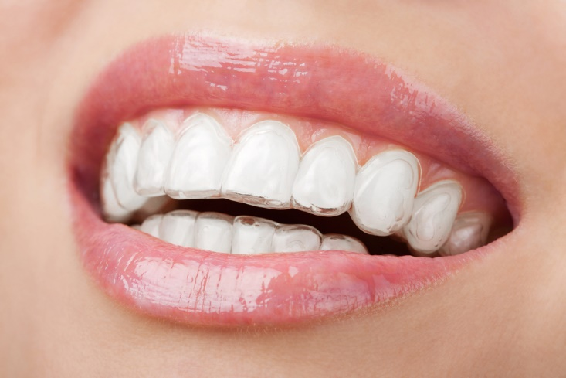
DECALCIFICATION FROM ALIGNERS
Notes:
AS YOU KNOW THESE ALIGNERS CAN HOLD PLAQUE, SUGARS AND FOOD DEBRI SECURELY AGAINST THE TEETH!!

Slide 68
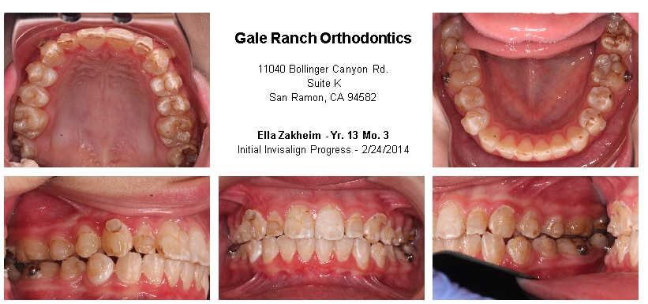
Notes:
HERE WE ARE AFTER ABOUT A YEAR OF TREATMENT. THIS PATIENT WAS MISSING APPOINTMENTS AND EATING AND DRINKING SODA OR OTHER SURGERY DRINKS—WITH THE ALIGNERS IN PLACE
IT CAN RESULT IN DECALCIFICATION AND DECAY SO BAD THAT EVERY TOOTH NEEDS A CROWN OR VENEER.
SINCE THESE CASES ARE OFTEN YOUNGER PATIENTS, THE PLAINTIFF’S ATTORNEY WILL ALWAYS CLAIM THAT THE CROWNS AND/OR VENEERS WILL HAVE TO BE REPLACED 2 OR 3 TIMES IN A LIFETIME—SO YOU CAN SEE THAT 28 RESTORATIONS REDONE 3 TIMES IN A LIFE ADDS UP TO A SIGNIFICANT AMOUNT OF MONEY—IT CAN BE WELL OVER $100,000.

Slide 69
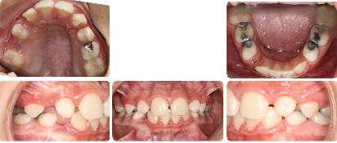
DECALCIFICATION WITH FIXED APPLIANCES
Notes:
WE CONTINUE TO SEE CLAIMS ABOUT CAVITIES WITH BRACES ALSO
ESPECIALLY IN STATES WITH LITTLE OR NO FLUORIDE IN THE WATER—SUCH AS OREGON WHERE I PRACTICED
THIS IS A YOUNG BOY AT THE BEGINNING OF TREATMENT

Slide 70
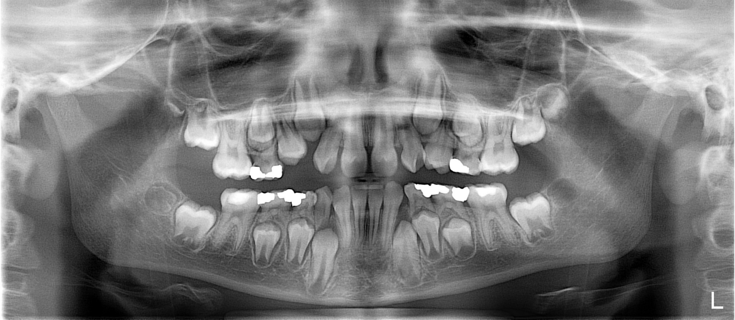
DECALCIFICATION WITH FIXED APPLIANCES
Notes:
TYPICAL CROWDING CASE

Slide 71
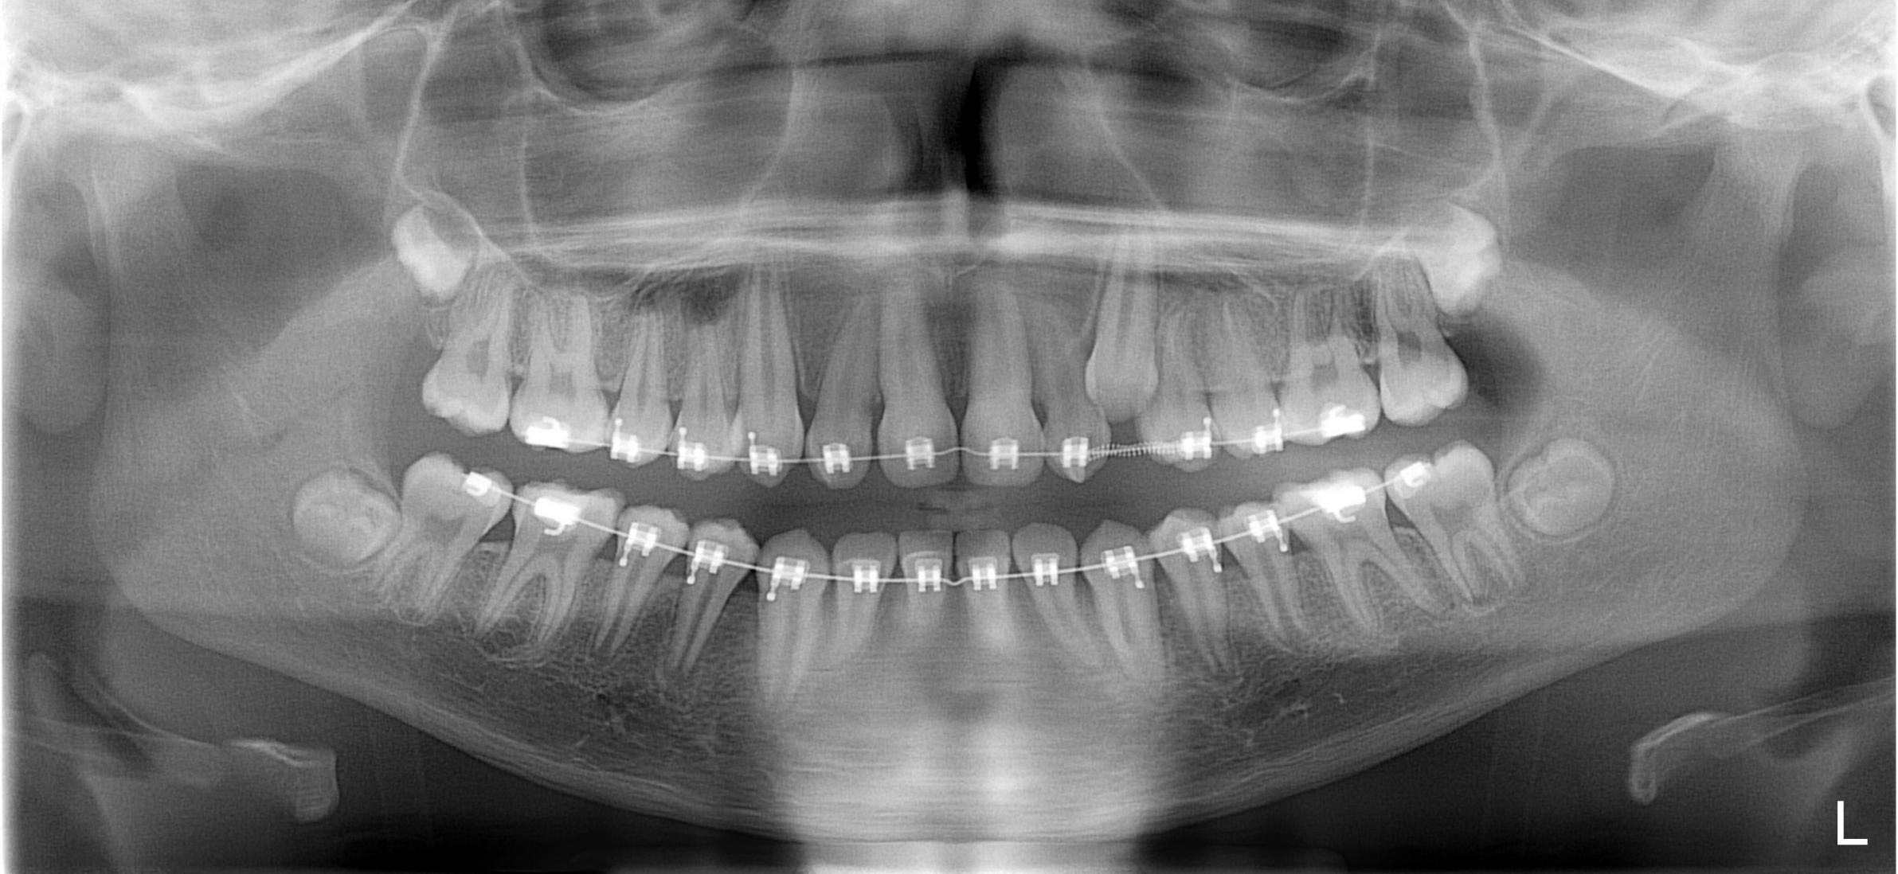
DECALCIFICATION WITH FIXED APPLIANCES
Notes:
RECOVERY THE LEFT CANINE DELAYED TREATMENT PROGRESS SOME

Slide 72
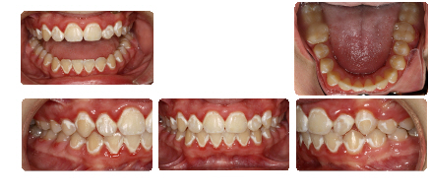
DECALCIFICATION WITH FIXED APPLIANCES
Notes:
GENERALIZED DECALCIFICATION ON EVERY TOOTH---SO WHAT HAPPENED?

Slide 73
DECALCIFICATION WITH FIXED APPLIANCES
SO WHAT DID OUR INSURED FAIL TO DO?
Male child was treated for 34 months
Some progress notes in the chart about POH early, but none later
First note of decalcification was made 28 months into treatment
There was lack of documentation in the chart that the patient had poor oral hygiene and no mention to the parents
There was no written notification to the parents documenting non-compliance with brushing
Notes:
THIS WAS A BREAKDOWN IN COMMUNICATION—
THIS CASE SETTLED FOR 6 FIGURES

Slide 74
Common reasons for a claim:
Failure to diagnose, manage periodontal disease--21%
Root resorption--17%
Impacted teeth—time plus root resorption, ankylosed teeth--12%
TMJ complaint (usually associated with additional complaints): 12%
Decalcifications, cavities, especially with clear aligners--7%
Other reasons: 31%
Notes:
“OTHER REASONS” IS A LARGE CATEGORY BECAUSE THERE ARE MANY MORE REASONS A CLAIM IS FILED

Slide 75
Common reasons for a claim:
Other reasons: 31%
Failure To Diagnose Pathology (Hemorrhagic Cyst,
Ameloblastomas, Dentigerous cyst, etc.)
Removing Too Much Enamel During Debonding or
During IPR
Cut Lip During IPR or Debond Procedure
Notes:
SOME EXAMPLES OF OTHER REASONS ARE---

Slide 76
Common reasons for a claim: What is the incidence?
OTHER REASONS: 31%
Latex ,Food, Metal Allergy
Chemical/Etchant Burns
Swallowing or Aspirate A Foreign Object
Poor Outcome
ETC……
Notes:
SOME EXAMPLES OF OTHER REASONS ARE---

Slide 77
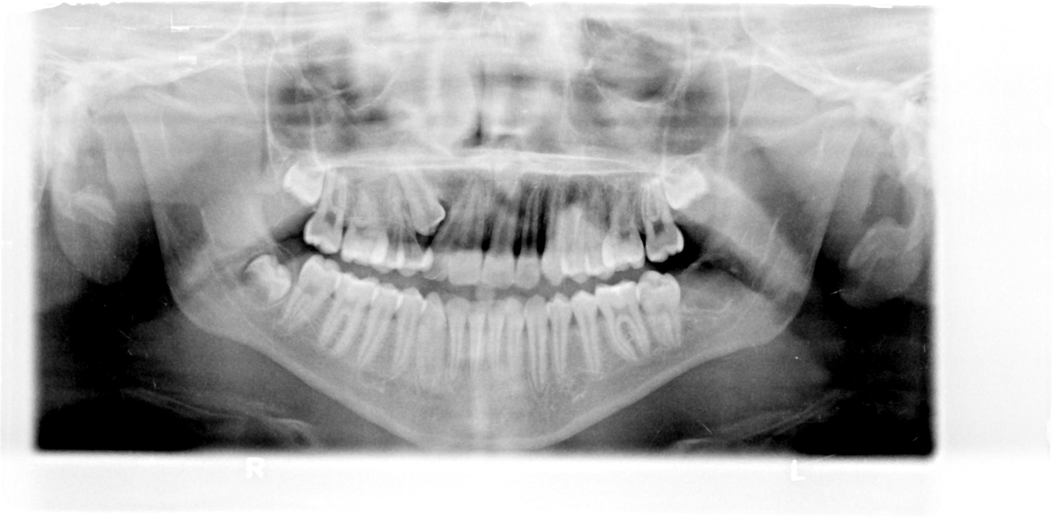
OTHER!!
APRIL 2010
Notes:
WE DON’T HAVE TIME TO GIVE AN EXAMPLE OF ALL OF THESE BUT THIS A CASE THAT ILLUSTRATES HOW IMPORTANT IT IS TO READ ALL FILMS TAKEN IN YOUR OFFICE.
DO YOU SEE ANYTHING SUSPICIOUS ON THIS FILM?
THE INSURED WAS VERY CONCERNED ABOUT THE IMPACTED CANINE

Slide 78
OTHER!!
APRIL 2010
Notes:
NOTE THE RED ARROW!

Slide 79
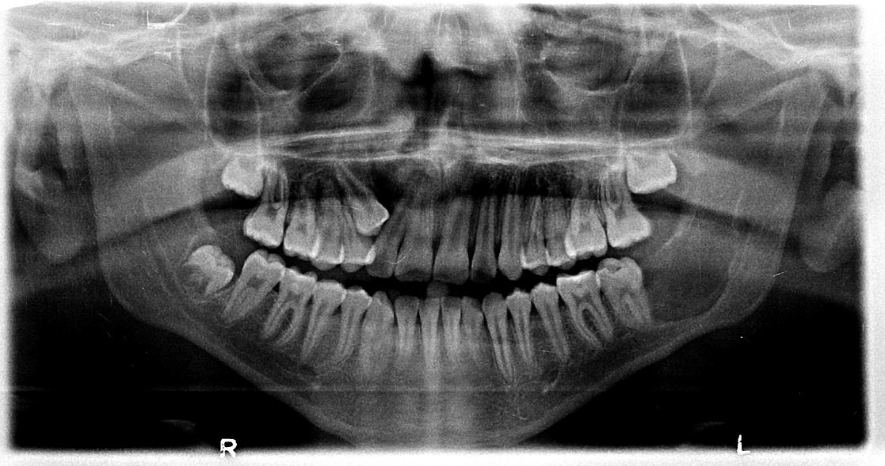
OTHER!!
JUNE 2011
Notes:
HOW ABOUT NOW? STILL NOTHING IN OUR INSURED’S CHART NOTES—STILL WORRIED ABOUT THAT IMPACTED CANINE THOUGH.

Slide 80
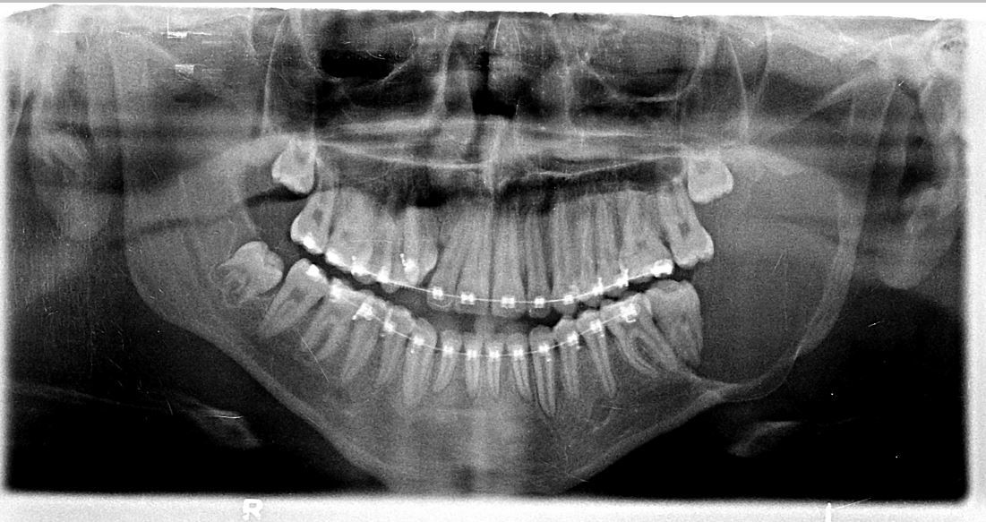
OTHER !!!
MARCH 2012
Notes:
HOW ABOUT NOW—ANYTHING TO CONCERN YOU? NOTE THE IMPACTED CANINE IS ABOUT IN NOW.
THIS SHOULD HAVE BEEN NOTED AS SUPICIOUS BACK IN 2010 AND CERTAINLY IN JUNE OF 2011, BUT NOT UNTIL THE PATIENT KEPT COMPLAINING ABOUT SWELLING ON THE LEFT SIDE DID THE INSURED DISCOVER THE LESION AND REFER TO AN ORAL SURGEON
IT TURNED OUT TO BE AN AMELOBLASTOMA AND REMOVAL INVOLVED LOSS OF MOST OF THE RAMUS AND PART OF THE MANDIBLE.

Slide 81
WHAT DID OUR INSURED FAIL TO DO?
Failed to carefully read his own initial xray and be suspicious
Took progress xrays, but failed to read them critically
Did not inform the patient about pathology
Result was the patient lost part of the left mandible and teeth
The case settled for over $120,000, but the patient was permanently disfigured.

Slide 82
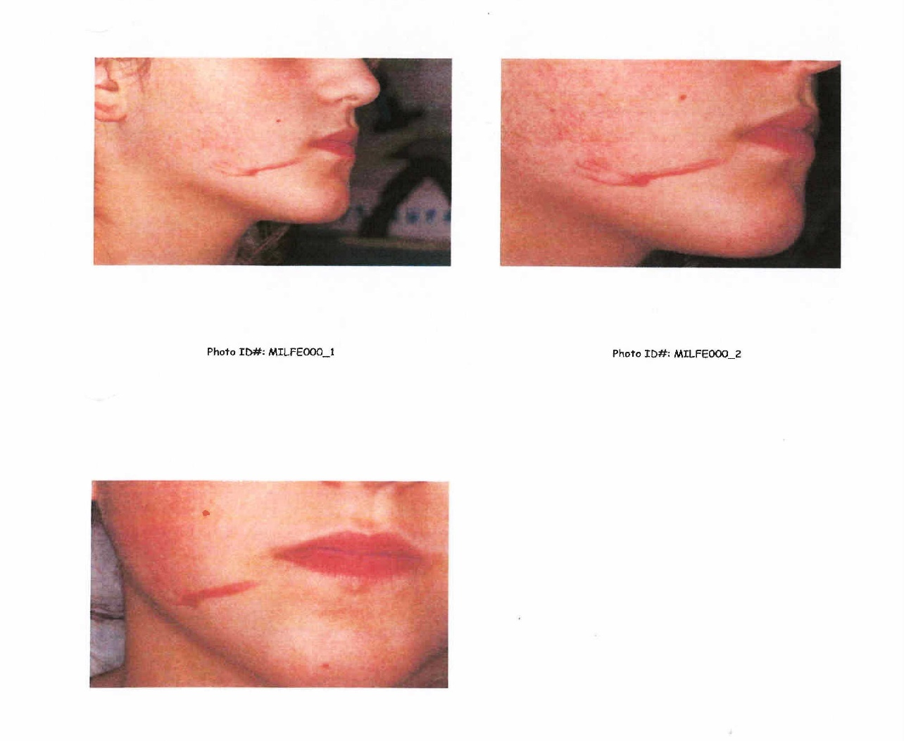
OTHER CASES Etchant Burn
This case settled for $190,000
Notes:
THESE PICTURES SPEAK FOR THEMSELVES. ETCHANT MATERIAL IS AN ACID AND IF LEFT ON THE SKIN IT WILL
BURN THE TISSUE—THE LONGER IT IS ON THERE THE DEEPER THE BURN.
LIQUID ETCHANT IS RISKER TO USE THAN JELL, BUT ALL MUST BE HANDLED CAREFULLY
THIS IS A CASE WHERE TECHNIQUE CAUSED THE PROBLEM—SOMETHING THAT WAS DONE WRONG—ECTHANT WAS ALLOWED TO CONTACT THE PATIENT’S SKIN

Slide 83
OTHER CASES
Patient 1010: age 50
Cause of Claim: Failure to diagnose pathology.
The insured saw the patient for two consults, a panorex was taken
The insured provided no treatment for the patient
At a later date, the patient was diagnosed with an Odontogenic Myxoma in another office
Notes:
IN THIS CASE THE INSURED WAS “CLEANING OUT HIS RECORDS” AND DESTROYED RECORDS OF THOSE PATIENTS THAT
DID NOT GO AHEAD WITH TREATMENT
DO NOT DESTROY RECORDS—AT LEAST DIGITIZE THEM IF THEY ARE HARD COPIES.
HOW LONG TO KEEP—FOR A LONG TIME—AND FOREVER IF POSSIBLE BECAUSE YOU NEVER KNOW

Slide 84
OTHER CASES
Patient 1010:
Cause of Claim: Failure to diagnose pathology.
The insured was named (among others) for not diagnosing the myxoma when he took an x-ray and consulted with the patient
He destroyed the panorex so we could not defend against the allegation of “failure to diagnose”. This was a failure to maintain records, and to read his xray.
The case settled for over $60,000 with $100,000 cost of defense
Notes:
DO NOT DESTROY RECORDS— DIGITIZE THEM IF THEY ARE HARD COPIES OR AT LEAST TAKE A PHOTO OF THEM.
HOW LONG TO KEEP—FOR A LONG TIME—AND FOREVER IF POSSIBLE BECAUSE YOU NEVER KNOW

Slide 85
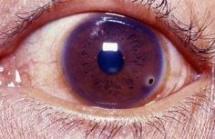
OTHER CASES
Patient 2010: age: Teenager
Cause of Claim: Eye injury
Notes:
READ SLIDE

Slide 86
OTHER CASES
Patient 2010:
Cause of Claim: Eye injury
Assistant was cutting an archwire to size
Assistant accidently dropped the sharp cutting instrument striking the cornea of the patient’s eye resulting in substantial injury
Corneal abrasions/injuries are very painful
The case settled for over $100,000
Notes:
READ THE SLIDE

Slide 87
OTHER CASES
What did our insured fail to do?
Failure to wear eye protection
Notes:
READ SLIDE

Slide 88
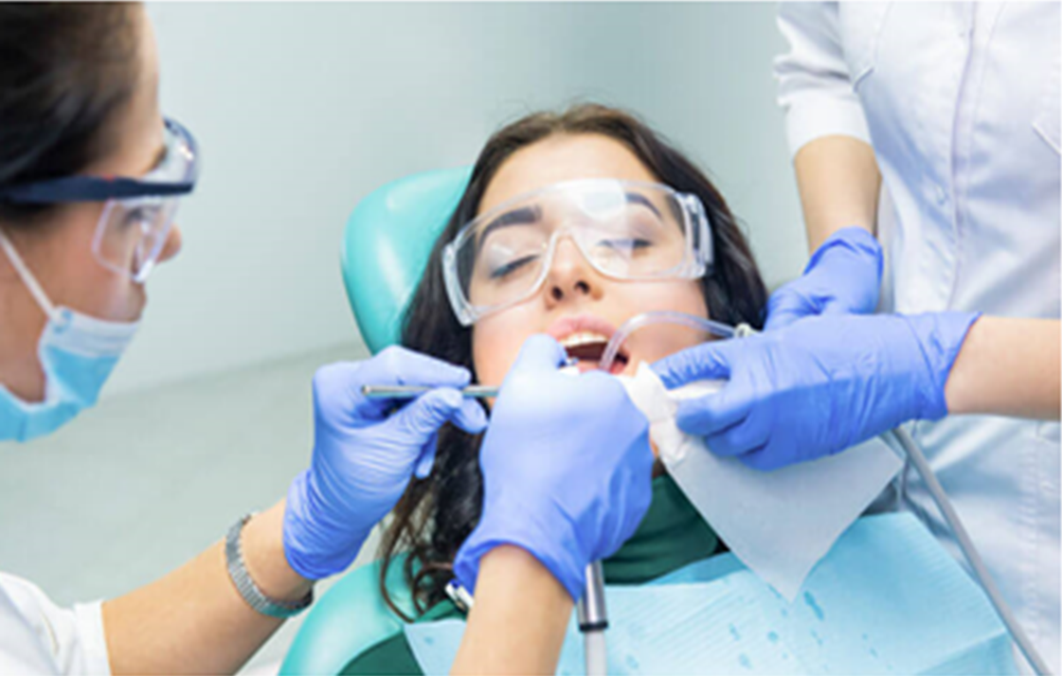
You must wear Protective Eyewear!
Notes:
BOTTOM LINE WEAR EYE PROTECTION EVERY TIME.
WE ARE SEEING MORE EYE INJURY COMPLAINTS IN THE LAST COUPLE OF YEARS AND THIS IS ONE THAT IS ENTIRELY PREVENTABLE.
SO YOU HAVE SEEN A WHOLE BUNCH OF EXAMPLES OF “WHAT YOU DIDN’T DO” THAT CAUSED A LAWSUIT
LET’S TALK A LITTLE ABOUT WHAT YOU CAN DO TO PROTECT YOURSELF FROM A LAWSUIT

Slide 89
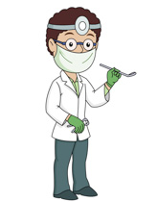
WHAT CAN I DO TO PROTECT MYSELF or HOW CAN I AVOID A LAWSUIT??
?
No 100% Protection
There are things you can do to reduce risk
Don’t be guilty of “failure to do
something”
Notes:
WHAT CAN YOU DO TO PROTECT YOURSELF. THE REAL ANSWER TO THAT QUESTION IS THIS:
THERE REALLY IS NO 100% PROTECTION. HOWEVER, THERE ARE THINGS YOU CAN DO TO REDUCE THE RISK AND MANY THINGS YOU CAN DO TO HELP YOUR DEFENSE IN CASE YOU ARE SUED.
YOU HAVE HEARD ALL OF THESE THINGS BEFORE BUT SOMETIMES IT IS BENEFICIAL TO GET BACK TO BASICS.
YOU DON’T WANT TO BE GUILTY OF “FAILURE TO DO SOMETHING” THAT COULD HAVE PREVENTED A LAWSUIT

Slide 90
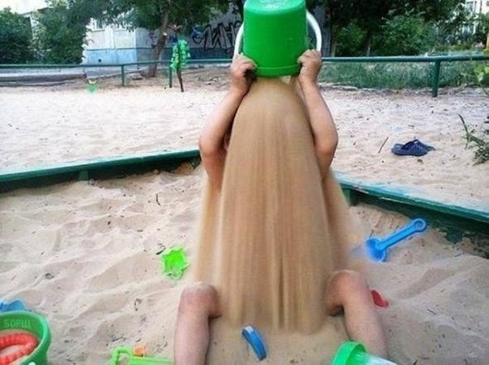
BACK TO BASICS: What can I do to Protect Myself?
Don’t bury your head in the sand!
Be proactive: use what you know as a dentist to protect yourself
Notes:
READ SLIDE

Slide 91
BACK TO BASICS: What can I do to Protect Myself?
Thorough medical and dental history
Thorough examination and document the chief complaint
Good quality photos, images (ceph, pano, CBCT), models
READ THE XRAY IMAGES!
Written diagnosis
Written treatment plan
Informed Consent (general and supplemental)
Treatment conference P+A+R+?
Chart notes (legible)
Progress images
Final records
DON’T FORGET YOU ARE A DENTIST
Notes:
MY FIRST ADVICE IS PROFOUND!! DON’T FORGET YOU ARE A DENTIST!! I AM GOING TO KEEP EMPHASIZING THAT
THESE ARE ALL THINGS WE WERE TAUGHT TO DO IN DENTAL SCHOOL---AND WE WILL TALK ABOUT EACH OF THESE SEPERATELY
OUR BEST DEFENSE IS THAT YOU HAVE THE RECORDS TO ALLOW A ROBUST DEFENSE IF YOU ARE NOT LIABLE.
LET’S SAY YOU HAVE MADE A MISTAKE AND YOU ARE LIABLE FOR SOMETHING—HAVING GOOD RECORDS ALLOWS US TO DEFEND YOU AND HOPEFULLY MITIGATE THE CLAIM.
THESE ARE ALL THINGS YOU KNOW TO DO, BUT THE KEY IS TO HAVE TO DISCIPLINE TO DO THEM EVERY TIME—
AND IF A PHOTO OR XRAY DOES NOT TURN OUT—THEN RETAKE IT—YOU NEVER KNOW WHEN THAT PHOTO OR IMAGE WILL BE NEEDED TO DEFEND YOURSELF.

Slide 92
TIPS TO AVOID A LAWSUIT
Do a thorough exam, discover the chief complaint and explain the problems you see
Take good quality records
READ THE XRAYS: Impactions, pathology, existing root resorption, bone loss
Adult patients: obtain a written periodontal clearance, if a surgical case refer to an oral surgeon pre-treatment for a consultation
Treatment conference: discuss P+A+R+?, and go over the informed consent
Progress xrays at least after 1 year, more often if there are impacted teeth, suspected root resorption or periodontal concerns
Communicate to the patient and referring dentist
Document EVERYTHING in the chart
Notes:
THIS IS SOMEWHAT OF A REPEAT OF THE LAST SLIDE—SO BE CAREFUL TO DO THESE THINGS—IT IS A BIG STEP TOWARD AVOIDING A LAWSUIT
THESE ACTIONS, WHEN NOT DONE, CAN LEAD TO A LAWSUIT—AND IF THEY ARE NOT DONE, DEFENDING AN INSURED BECOMES VERY DIFFICULT

Slide 93
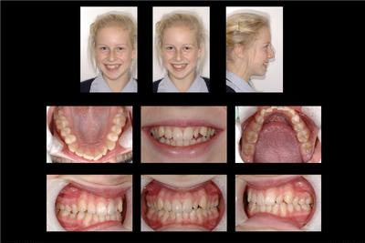
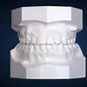
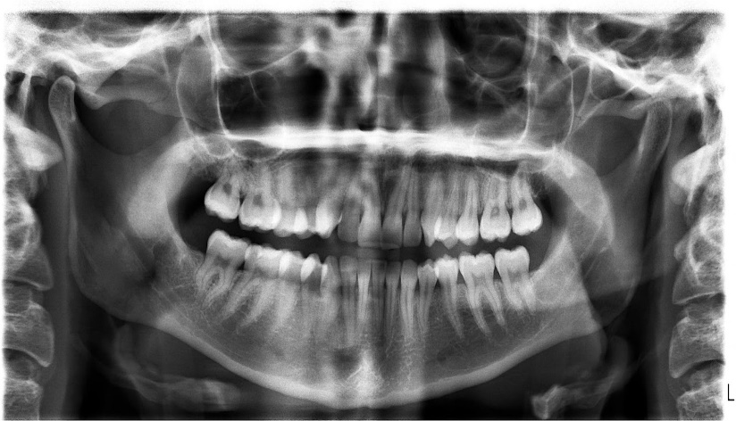
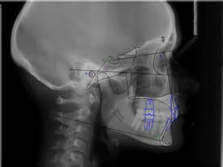
BACK TO BASICS: What can I do to Protect Myself? Good Quality Records
Notes:
RECORDS SHOULD INCLUDE PHOTOS SHOWING THE OCCLUSAL SURFACES OF THE TEETH AND MOLAR RELATIONSHIP AND IMAGES SHOULD INCLUDE A CEPHELOMETRIC XRAY, A PANOREX OR FULL MOUTH SERIES.
THERE ARE PRACTICES THAT USE CBCT TO GENERATE CEPH AND PANOREX TYPE IMAGES.
THE KEY TO ALL IMAGES AND PHOTOS IS THAT THEY ARE READABLE. AN IMAGE THAT IS TOO DARK OR TOO LIGHT SHOULD BE RETAKEN BECAUSE IT IS NOT DIAGNOSTIC.
WE GET PHONE CALLS MOST EVERY WEEK AT THE AAOIC OFFICE ASKING: “DO WE REALLY NEED TO TAKE MODELS?”
OUR ANSWER IS THAT THERE IS NO BETTER REPRESENTATION OF THE AMOUNT OF CROWDING AND THE OCCLUSAL RELATIONSHIP OF THE PATIENT’S TEETH THAN PLASTER OR VIRTUAL MODELS. THEY ARE STRONG EVIDENCE OF WHERE YOU STARTED AND ENDED UP WITH THE TREATMENT YOU PROVIDED.
WHETHER IT IS THE PHOTOS OR THE MODELS, TAKING THOSE IN CR IS MUCH BETTER AND MORE DIAGNOSTIC THAN CO.

Slide 94
BACK TO BASICS: What can I do to Protect Myself?
Written diagnosis
What are the problems-list them out
Orthodontic diagnosis: “Class II, Div. I, U/L crowding with 7mm overjet and 100% overbite. Tooth number 6 palatally impacted.”
Written treatment plan
Address the chief complaint
What are your recommendations/options ?
What if we do nothing?
P+A+R+?
Notes:
HAVING A WRITTEN DIAGNOSIS IS IMPORTANT TO SHOW THAT YOU RECOGNIZE WHAT THE ORTHODONTIC PROBLEMS ARE.
MAKE A PROBLEM LIST, IT IS ALWAYS BETTER TO ADDRESS ALL ISSUES—EVEN IF THEY ARE NOT CONCERNS OF THE PATIENT.
ONE OF THE THINGS WE OFTEN SEE MISSING IN MALPRACTICE CLAIMS IS A WRITTEN TREATMENT PLAN.
IT GIVES THE PLAINTIFF AND THEIR EXPERT WITNESS AN OPENING TO ACCUSE YOU OF NOT HAVING A PLAN TO PROPERLY TREAT THE CASE.
ADDRESS THE PATIENT/PARENT’S CHIEF COMPLAINT AND WHAT YOU ARE GOING TO DO ABOUT IT IF ANYTHING. CLEARLY EXPLAIN YOUR TREATMENT RECOMMENDATIONS AND WHAT OPTIONS THE PATIENT MAY HAVE.
I LIKE TO USE THE ACRONYM P+A+R+?.

Slide 95
BACK TO BASICS: What can I do to Protect Myself?
What are the patient’s options? P+A+R+ ?
Procedure(s)—what are you recommending?
Alternatives—what options are there?
Risks—what are pros/cons risks of treatment
? Chance to ask questions
Notes:
PROCEDURE + ALTERNATIVES + RISKS+ QUESTIONS.
IF THIS WAS IN EVERY CHART FOR EVERY PATIENT YOU TREAT—THAT YOU PROCEDURES YOU ARE RECOMMENDING
ALTERNATIVES OF TREATMENT—INCLUDING DOING NOTHING
RISKS THAT MIGHT BE ENCOUNTERED
ASK QUESTIONS PARENTS/PATIENTS HAVE CHANCE TO ASK QUESTIONS
YOU HAVE PROVIDED A MIGHTY TOOL TOWARD YOUR DEFENSE.
I REALIZE THAT MANY OF OUR CURRENT PRACTICE MANAGEMENT CONSULTANTS FEEL THAT THIS CAN ALL BE DELEGATED TO YOUR TREATMENT COORDINATOR OR OTHER STAFF—
JUST REMEMBER THAT SHOULD YOU BE SUED, THE PLAINTIFF’S ATTORNEY MAY ASK IF YOU EXPLAINED THE TREATMENT TO THE PATIENT—DID YOU EXPLAIN THE RISKS TO THE PATIENT? YOU WANT TO BE ABLE TO ANSWER “YES” TO THOSE QUESTIONS. IT IS NOT YOUR STAFF THAT WILL BE SUED—IT WILL BE YOU.
INFORMED CONSENT IS EXTREMELY IMPORTANT AND IT IS ALL PART OF THE NEXT SLIDE

Slide 96

BACK TO BASICS: What can I do to Protect Myself?
Informed Consents:
General—use the AAO Comprehensive Informed consent
I.C. should be in the main language of the patient/parent
Available in French, English and Spanish—do you have a translator?
Informed consents are doctor specific---new doc=new consent
Case specific “Supplemental” Informed Consents
Go to AAOIC.COM
Notes:
INFORMED CONSENT. I HAVE ALREADY DISCUSSED THE IMPORTANCE OF EXPLAINING THE TREATMENT TO THE PATIENT AND USING THE ACRONYM P+A+R+? TO FULLY INFORM THE PATIENT, IT IS NECESSARY TO HAVE A WRITTEN AND SIGNED INFORMED CONSENT DOCUMENT.
WE WOULD RECOMMEND THE AAO COMPREHENSIVE INFORMED CONSENT, BUT IF YOU HAVE A FORM THAT COVERS ALL THE TOPICS CONTAINED WITHIN THE AAO FORM THAT CERTAINLY WOULD WORK.

Slide 97
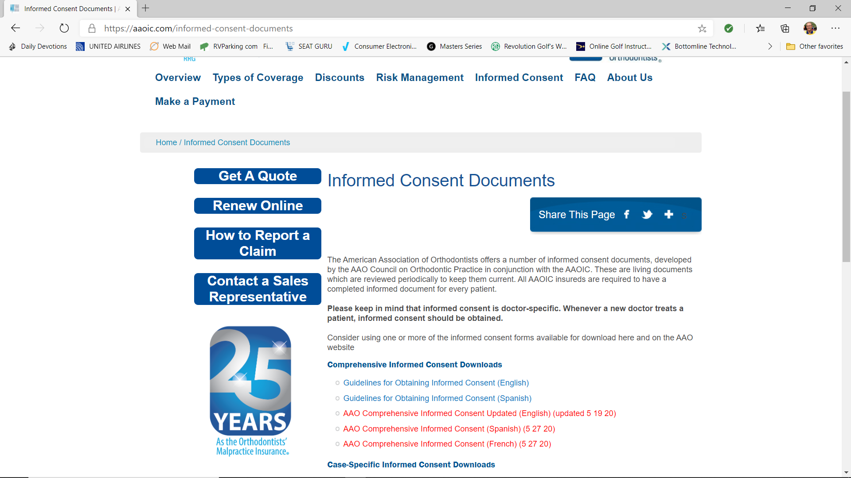
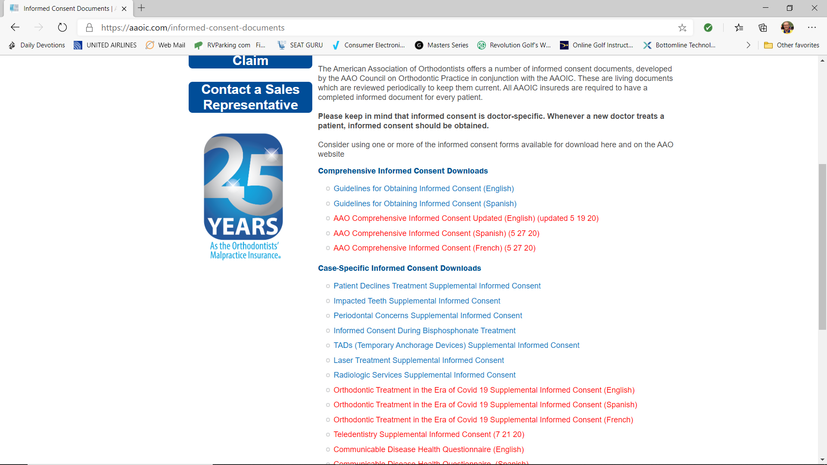
GENERAL INFORMED CONSENTS AND SUPPLEMENTAL INFORMED CONSENTS
Notes:
YOU WILL SEE SUPPLEMENTAL INFORMED CONSENTS THAT COVER THOSE ISSUES THAT ARE MOST LIKELY TO GENERATE A CLAIM.
THESE INFORMED CONSENTS HELP GUIDE THE DISCUSSION OF THE RISKS OF ORTHODONTIC TREATMENT FOR THE PATIENT AND BY THEM
SIGNING IT, SHOWS THEY WERE INFORMED OF THE RISKS OF TREATMENT AND POTENTIAL PROBLEMS THAT COULD ARISE.
HERE IS A SCREEN SHOT OF OUR WEBSITE—AAOIC.COM---JUST CLICK ON INFORMED CONSENTS—THEY ARE FREE TO DOWNLOAD

Slide 98
GENERAL INFORMED CONSENTS AND SUPPLEMENTAL INFORMED CONSENTS
Guidelines for Obtaining Informed Consent
Comprehensive Informed Consent (English, French and Spanish)
Periodontal Concerns Supplemental
Impacted Teeth Supplemental
Notes:
THERE ARE SEVERAL DOCUMENTS THAT SPEAK TO SPECIAL CIRCUMSTANCES IN YOUR TREATMENT

Slide 99
GENERAL INFORMED CONSENTS AND SUPPLEMENTAL INFORMED CONSENTS
TAD Supplemental
Laser Treatment Supplemental
Radiological Services Supplemental
Patient Declines Treatment Supplemental
Bisphosphonate Supplemental
Orthodontic Treatment in the Era of Covid 19
Teledentistry Supplemental Informed Consent
Communicable Disease Health Questionnaire
Notes:
USING THESE SUPPLEMENTAL INFORMED CONSENTS AS WELL AS THE COMPREHENSIVE INFORMED CONSENT WILL HELP STRENGTHEN YOUR POSITION.
IF YOU REMEMBER THE INCIDENCE OF CLAIMS THAT I SPOKE OF EARLIER, 50% OF CLAIMS COME FROM PERIO ISSUES OR ROOT RESORPTION. THE CASE SPECIFIC INFORMED CONSENTS GO INTO MORE DETAIL IN EXPLAINING RISKS SO THAT YOUR PATIENT IS FULLY INFORMED AND YOU CANNOT LATER BE ACCUSED—WHICH IS MOST TIMES THE CASE—THE DOCTOR DIDN’T TELL ME THAT COULD HAPPEN
I KNOW THAT SOME OF YOU MAY BE RELUCTANT TO BRING UP THE NEGATIVE THINGS THAT COULD HAPPEN IN TREATMENT FOR FEAR IT MIGHT “SCARE THE PATIENT OFF”.
AS I HAVE SAID BEFORE---EVERYTHING YOU TELL THE PATIENT IN ADVANCE IS A WISE WARNING—EVERYTHING YOU TELL THE PATIENT AFTER A PROBLEM ARISES IS AN EXCUSE”
BE BOLD AND TELL IT LIKE IT IS—IT WILL PROTECT YOU IN THE LONG RUN. AND IF YOU THINK ABOUT IT—IF A PATIENT IS “SCARED OFF” WHEN YOU DISCUSS THE RISKS OF TREATMENT—YOU PROBABLY ARE BETTER OFF NOT TREATING THAT PATIENT IN THE FIRST PLACE.

Slide 100

BACK TO BASICS: What can I do to Protect Myself?
Chart notes:
Write so it can be read!!
In chronological order by date
Who provided the treatment, what was done, which assistant and which orthodontist
Any patient concerns, conversations and/or instructions
Chart the level of compliance—quantitative vs. subjective
Notes:
READ SLIDE

Slide 101

BACK TO BASICS: What can I do to Protect Myself?
NO alteration of the chart:
No white-out, erasing or scribbled out—one line through if a mistake
Use ink, not pencil
If you forgot to say something, go back later—note that it is a late entry and then what it is. Keep in order.
Never let this record out of your office!!
Notes:
LIZ READ SLIDE

Slide 102

Electronic Records Rules
No Alterations!!
Metadata—embedded, unseen tracking of all keystrokes, deletions, changes.
Audit trail—you cannot hide attempted changes to the electronic record
Back up—off site, multiple backups: systems will fail
Encrypt to protect privacy
Use passwords, firewalls, etc., change passwords when employee leaves
Make sure you document everything—the tendency with computer charting is reduction in details of the treatment
Notes:
LIZ--READ SLIDE

Slide 103

BACK TO BASICS: What can I do to Protect Myself?
Treatment conference P+A+R+?
Having time set aside to explain the treatment is recommended.
Communication (or lack of) is a main complaint in filed claims.
Staff can do a lot of the conference; you must do the important part.
Notes:
DR. V
WE HAVE ALREADY DISCUSSED THE IMPORTANCE OF DEVELOPING A TREATMENT PLAN AND ALTERNATIVES,
BUT IT MUST BE COMMUNICATED CLEARLY TO THE PATIENT—
YOU MUST DO THE IMPORTANT PART—
EXPLAINING THE TREATMENT, GOING OVER THE ALTERNATES AND ADVISING OF THE RISKS.
.

Slide 104
BACK TO BASICS: What can I do to Protect Myself?
Treatment Conference
Do what I tell you
Vs.
Let’s do this together
Patient Engagement/Satisfaction
Improved Compliance
More Referrals
Less Past Due
Liability Risk Reduced
Notes:
TREATMENT CONFERENCES ARE NOT A BOTHER—THEY ARE AN OPPORTUNITY
RECENT RESEARCH BY SAXTON AND HAMMER OF HEATHCARE QUALITY CONSULTING ON A LARGE PATIENT GROUP SHOWED THAT HOW YOU PRESENT TREATMENT CAN PROFOUNDLY INFLUENCE WHAT HAPPENS NEXT
SPEND ADEQUATE TIME WITH THE PATIENT TO DEVELOP A RELATIONSHIP—MAKE THE PATIENT/PARENT FEEL PART OF THE DECISION MAKING PROCESS AND TREATMENT---THIS RESULTS IN PATIENT SATISFACTION AND “ENGAGEMENT” WITH THE PATIENT AND/OR PARENTS.
THE STUDY FOUND IMPROVED COMPLIANCE, MORE REFERRALS, LESS PAST DUE AND LESS LIABILITY RISK

Slide 105

IMPORTANCE OF COMMUNICATION!!
Notes:
THE ART OF COMMUNICATION

Slide 106

BACK TO BASICS: What can I do to Protect Myself?
Communication to patient/parent, referring dentist, etc.:
Develop a protocol of letters that substantiates what you have advised the patient/parent
Advise your referring dentist of your agreed upon treatment plan
Develop a protocol of letters that warn of non-compliance (brushing, elastics, appointments, etc.)
Notes:
A FAILURE TO COMMUNICATE—OF COURSE IT WON’T BE ANYTHING AS SEVERE AS IN “COOL HAND LUKE” BUT……
READ SLIDE
A COMMON THREAD IN CLAIMS WE SEE IS A PERCEIVED LACK OF COMMUNICATION

Slide 107

BACK TO BASICS: What can I do to Protect Myself?
Progress images—when?
About ½ through treatment—about the 1-year mark
More often for perio issues or impacted teeth or initial concern about root resorption or bone loss
Slow or difficult progress with treatment
Is the patient dissatisfied with progress?
Document what you see in the progress images
Notes:
WE ALL WANT TO PRACTICE WITH THE ALARA PRINCIPLE IN MIND—AS LOW AS REASONABLE ACHIEVEABLE.
USE COMMON SENSE---BUT TAKE THOSE IMAGES THAT PROTECT THE PATIENT—AND YOU.
AND GET THIS—THIS IS IMPORTANT—IF YOU TAKE AN XRAY YOU MUST READ IT!! IF IT IS NOT DIAGNOSTIC—TAKE IT AGAIN!!

Slide 108

BACK TO BASICS: What can I do to Protect Myself?
Final Records or Transfer-out Records:
Document patient’s condition at the end of treatment
Post treatment conference?
Document patient’s condition when they transfer out.
At least get photos
Notes:
READ SLIDE
FINAL RECORDS OR TRANSFER OUT RECORDS:
IF YOU ARE FINISHED WITH TREATMENT OR SOMEONE IS MOVING OR YOU EVEN THINK SOMEONE MIGHT BE LEAVING YOUR PRACTICE—TAKE PROGRESS RECORDS—AT LEAST TAKE GOOD PHOTOS SO YOU CAN PROVE THE TREATMENT YOU PROVIDED.

Slide 109
BACK TO BASICS: What can I do to Protect Myself? Summary
Communication to patient/parent/referring dentist
Good quality records—photos, models, images
Treatment conference with Informed Consent, P+A+R+?
Notes:
IN SUMMARY:
IT IS ALWAYS HARD TO TALK ABOUT THE BAD THINGS THAT CAN HAPPEN TO US IN OUR PRACTICES.
JUST REMEMBER—THAT A LITTLE CARE WITH COMMUNICATION, RECORDS AND RECORD KEEPING CAN PROTECT YOU SIGNIFICANTLY—AND ADD TO YOUR PEACE OF MIND THAT YOU HAVE DONE EVERYTHING YOU CAN TO PROTECT YOURSELF.
DO WHAT YOU HAVE ALL BEEN TAUGHT
DEVELOP THOSE PROTOCOLS AND SYSTEMS THAT ALLOW YOU TO PRACTICE WITHOUT “RE-INVENTING THE WHEEL” EACH DAY
DO THAT AND YOU CAN GO OUT AN ENJOY LIFE---HERE IS WHAT I LIKE TO DO WHEN NOT WORKING!!
LIZ IS GOING TO TALK TO ABOUT SOME OTHER ISSUES YOU MAY SEE IN YOUR OFFICE

Slide 110
BACK TO BASICS: What can I do to Protect Myself? Summary
Thorough written records:
Written diagnosis and treatment plan
Treatment notes
Record of patient compliance/progress letters where appropriate
Interaction with parents/patients
Progress records where appropriate
Final records/post treatment conference
Notes:
IN SUMMARY:
IT IS ALWAYS HARD TO TALK ABOUT THE BAD THINGS THAT CAN HAPPEN TO US IN OUR PRACTICES.
JUST REMEMBER—THAT A LITTLE CARE WITH COMMUNICATION, RECORDS AND RECORD KEEPING CAN PROTECT YOU SIGNIFICANTLY—AND ADD TO YOUR PEACE OF MIND THAT YOU HAVE DONE EVERYTHING YOU CAN TO PROTECT YOURSELF.
DO WHAT YOU HAVE ALL BEEN TAUGHT
DEVELOP THOSE PROTOCOLS AND SYSTEMS THAT ALLOW YOU TO PRACTICE WITHOUT “RE-INVENTING THE WHEEL” EACH DAY
LIZ IS GOING TO TALK TO ABOUT SOME OTHER ISSUES YOU MAY SEE IN YOUR OFFICE

Slide 111

Notes:
LIZ IS NOW GOING TO TALK TO YOU ABOUT THOSE PATIENTS YOU HATE TO SEE COME INTO YOUR OFFICE—
ALSO KNOWN AS DIFFICULT PATIENTS

Slide 112

Managing Difficult Patients
Notes:
LIZ
READ SLIDE

Slide 113

Managing Difficult Patients
Ramifications of difficult patients
Poor treatment of you or your staff
May try to dictate treatment
Demanding on appointment times yet often fail appointments—hate to see on the schedule
Tend to be disruptive to your practice day
Early recognition is critical
It is OK to say “No”
Screening process – doctor and staff
Termination of treatment/dismissal
Notes:
READ THE SLIDE

Slide 114

Practice/Admin Problems that Increase Risk of a Lawsuit
Poor Communication to the patient/parent
Money issues– (i.e. Charges for broken appliance repair, etc.)
Appointment times/delays in schedule
Etc.
Notes:
WHEN PEOPLE BECOME ANGRY WITH YOU AND/OR YOUR PRACTICE FOR ANY REASON, IT CAN INCREASE THE POSSIBILITY OF A LAWSUIT
SOME OF THE THINGS WE SEE THAT PERCIPITATE A LAWSUIT ARE:
READ SLIDE

Slide 115
More Practice Admin problems…
Group practices:
Changing orthodontist frequently (lack of continuity of care)
Lack of informed consent for new orthodontist
Lack of familiarity with patient dental/medical history
Missing key problems (i.e. perio; POH, poor compliance, etc.)
Understaffing
Notes:
THERE IS NOTHING WRONG WITH GROUP PRACTICES-BUT THERE ARE SOME SPECIAL ISSUES THAT SHOULD BE ADDRESSED BY THE OWNER OF THE PRACTICE-OR IF YOU ARE WORKING FOR A GROUP.
READ THE SLIDE

Slide 116

Notes:
THANKS LIZ
NEXT SLIDE

Slide 117

Was it worth your time today?
Based on AAOIC claims data, insureds who have taken our risk management courses have 25% fewer claims than insureds who have not.
Think of AAOIC as your partner in practice!
Notes:
DR. VARNER
READ SLIDE

Slide 118
Visit AAOIC.com today!
Thank you for your attendance!
For premium credit, don’t forget to take the test
Notes:
READ SLIDE

Slide 119
PROGRAM
END

